Slide 1
Leading the Pack:
What I Need to Know as President
Ann Kvach
Huntsville Council of PTAs President
Summer Leadership Training 2018

Slide 2
Let’s start at the very beginning . . .
The overall purpose of PTA is to make every child’s potential a reality by engaging and empowering families and communities to advocate for all children.

Slide 3
6 National PTA
Family-School Partnership Standards

Slide 4
Keep it Legal

Slide 5
What are the rules that govern your PTA?
State Laws
Raffles? No!
Sales tax exempt? No!
Federal Laws
File 990 every year
Regulates what you can & can’t do as a nonprofit (501c3)
Robert’s Rules of Order
Bylaws
Board, officers, committees
Length of terms
Elections
Dues
Meetings
Budget approval
Must be updated every three years

Slide 6
What does it mean to be in “Good Standing?”
(i) Adheres to the purposes and basic policies of PTA (ii) Remits dues to Alabama PTA at least once by December 1
(iii) Has a current officer list on file in the Alabama PTA office,
(iv) Has bylaws which have been updated within the last three (3) years on file in the Alabama PTA Office
(v) Has maintained its 501c(3) tax exempt status or is actively working in conjunction with Alabama PTA to have its tax exempt status reinstated
(vi) Has maintained membership levels as follows: A minimum of 15 members for schools with enrollment of 200 or less students, 25 members for schools with enrollment of 201 to 500 students, and 50 members for schools with enrollment of greater than 500 students,

Slide 7
(vii) If located with an organized council, follows adopted guidelines of that council in paying dues and/or participating in other programs. (For HCPTA this is paying your dues to us by October 1.)
WHY IS IT IMPORTANT TO BE IN GOOD STANDING? Your PTA must be in good standing to
• Apply for fall and spring grants from the Huntsville Council of PTAs
• Receive awards from the Huntsville Council of PTAs and Alabama PTA
• Participate in Reflections, the National PTA arts program
• Allow organizations from your school to work the concession stands at Milton Frank Stadium and receive a percentage of the sales

Slide 8
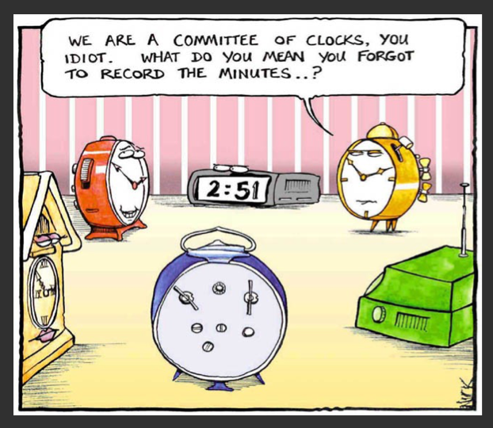

Slide 9
Financial Focus

Slide 10
What does a president really need to know about the money?
President is legally responsible for making sure that the organization is in compliance with its bylaws.
Money issues are one of the top reasons for problems within a PTA.
A wise president makes sure that the policies and procedures concerning money are followed:
Annual financial review
Two signatures on all checks
Two people present when counting money
No debit card - never, ever, ever!
AIM insurance

Slide 11
Communication 101

Slide 12
Let’s Talk!
Communication issues are one of the top reasons for problems within a PTA.
You set the tone for your organization.
Be sure that you are communicating effectively with all of your constituencies:
Principal
Board
Membership
School community
Elected officials
Community partners & supporting PTA organizations
Lots of tools - Constant Contact, MailChimp, FB, Instagram, Twitter . . .

Slide 13
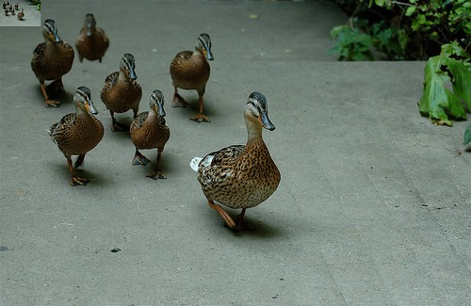
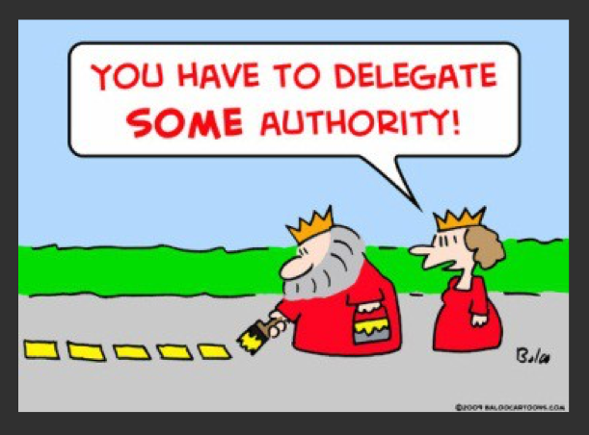
Leading the way so that others will follow

Slide 14
How to delegate effectively
Not every idea is a good one.
Not every good idea must be pursued.
Invest time in planning.
Who? What? When? Where?
Empower your board to do their jobs.
Power to the people! Use committees to break tasks down into smaller chunks.
Show appreciation to your volunteers!

Slide 15
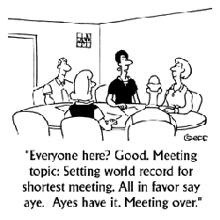
How to run an effective meeting
Realize that time is people’s most limited resource.
Respect the time of your participants.
Have an agenda
Set time constraints for the meeting; be realistic from the outset.
Don’t let one person dominate the meeting.
Provide meaningful information.

Slide 16
Why join PTA?

Slide 17
To fail to plan is to plan to fail
What are the 2-3 big events that you want to host at your school this year?
It is better to do a few things well than to do many things poorly.
Establish a calendar before the year starts so that you can get a big picture of what your PTA will accomplish.
Evaluate your calendar using the six national PTA standards. Do your programs support the PTA mission and standards?

Slide 18
Relax . . .

Slide 19
You have LOTS of Support!
www.pta.org
Back-to-School Kit
elearning courses
www.alabamapta.org
www.huntsvillepta.org
www.facebook.com/huntsvillepta
huntsvillepta@gmail.com
Ann Kvach, akvach04@hotmail.com, 256-731-9056

