Slide 1
“How To Engage The Community in the Work of Your PTA”
Rena Anderson, Director, Community Engagement
July 22, 2017

Slide 2
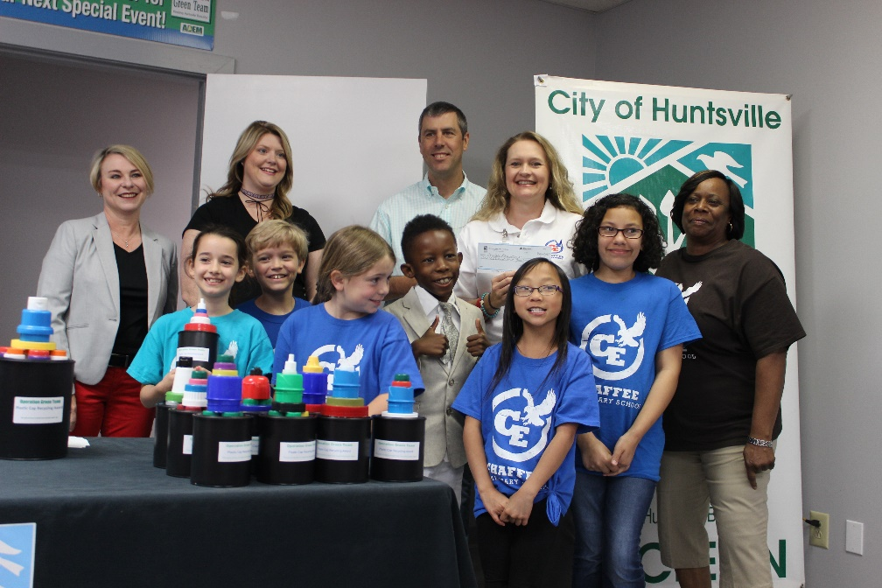
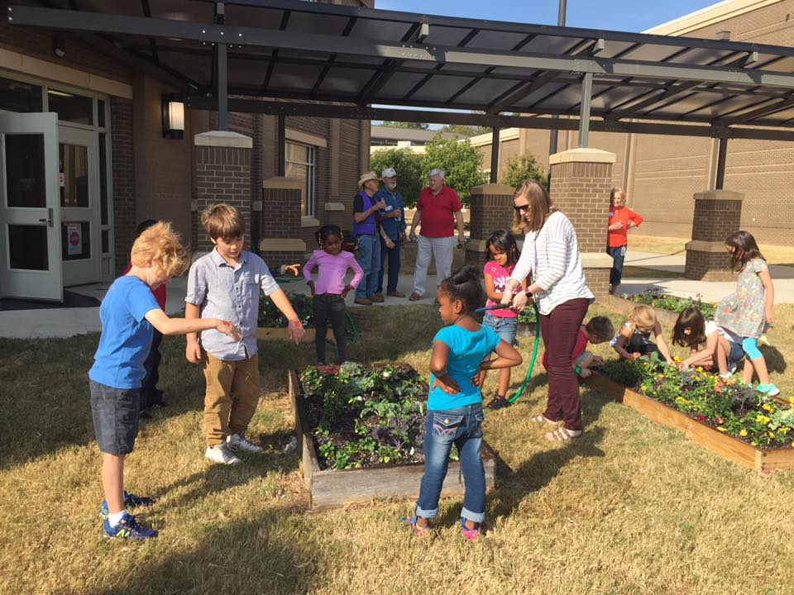
Huntsville City Schools Partners with Local Businesses, Municipalities, Non-Profit Organizations, Faith Based Organizations, etc. To Enhance The Mission of the School District & Engage The Community & Parents
PTA Values:
Collaboration – Individuals/Community working together to achieve common goal
PTA National Standard #6 – Collaboration
Expand learning opportunities
Community service
Civic participation
Make sure your community relations efforts and strategies align with the schools goals/objectives – must speak with One Voice as a School Family
It’s not enough for us to do NICE Work… we must have impactful work

Slide 3
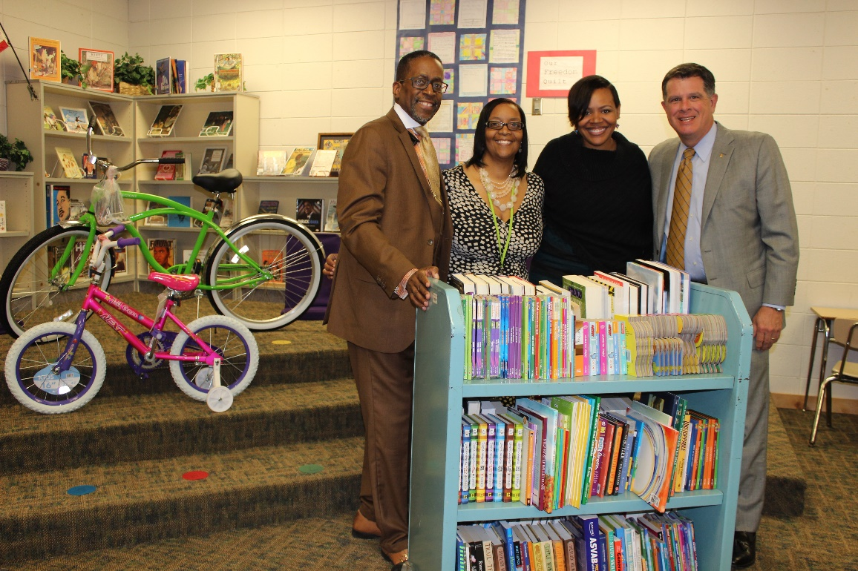
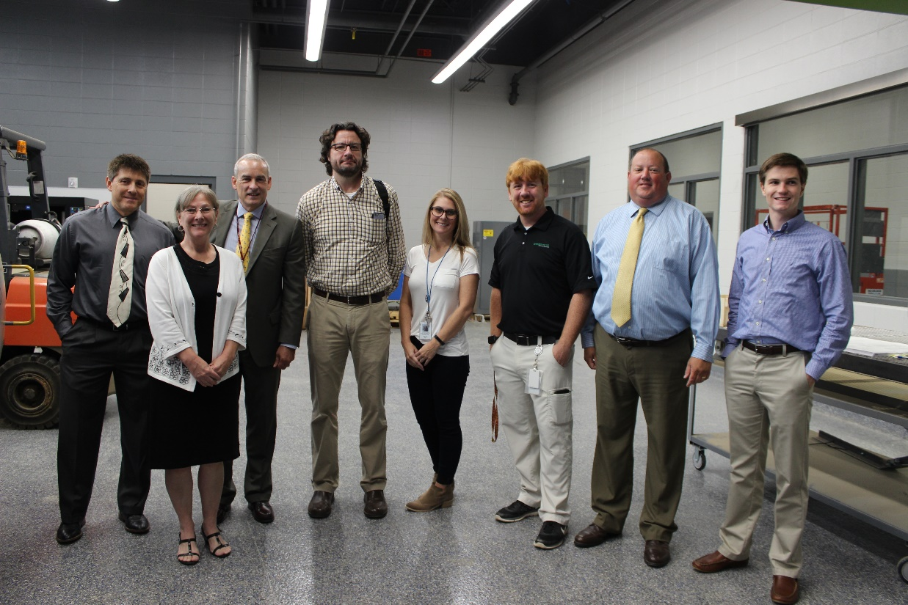
Focus On Partnerships To Enhance The Mission of the School District & To Engage The Community & Parents
AMRDEC – Partnership/MOU for Advanced Manufacturing
Huntsville Hospital – Suicide Awareness Project (SPEAK APP)
Second Mile Development (Parent Parties)
Huntsville Council of PTA
Christmas Charities – Mobile Clothes Closet Project for 2017/18
Bicentennial Committee/EarlyWorks

Slide 4
Engage The Community Via Speaking Engagements, School Tours, Parent Workshops, Career Fairs, Collection Drives (Box Tops/Bottlecaps) etc.
Examples and Ideas:
Family nights/Coffee Talk/Parent University – curriculum demos, how to read/use Edmodo, digital citizenship, cool math games and other learning tools – survey families to find out what they want to learn about and how they prefer to be engaged
Attendance Awareness Month – September – Community Campaign
College & Career Events – College Week in Sept.
Character Education – invite community to
participate each month – include
in the home, business, church, clubs, etc.
Character Education Word for August 2017 = School Pride
Ask community organizations to promote their pride/support for your school!
Celebrate school anniversaries/milestones (Montview ES will be celebrating 50th anniversary this Fall)

Slide 5
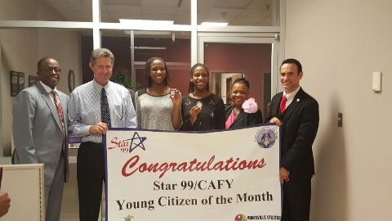
Serve as the Connector for Families and the Community
Promoting additional community events for our families – be the GO TO resource connecting families with the community:
CAFY 2017– July 29th^{th} @10:00am
https://www.facebook.com/HuntsvilleCAFY
CAFY/95.1 Young Citizen of the Month - http://therocket951.com/?p=1418

Slide 6
Serve as the Connector for Families and the Community
Celebrating Education Parade – Education Celebration -
August 5th @ Jemison August 12th @ Grissom

Slide 7
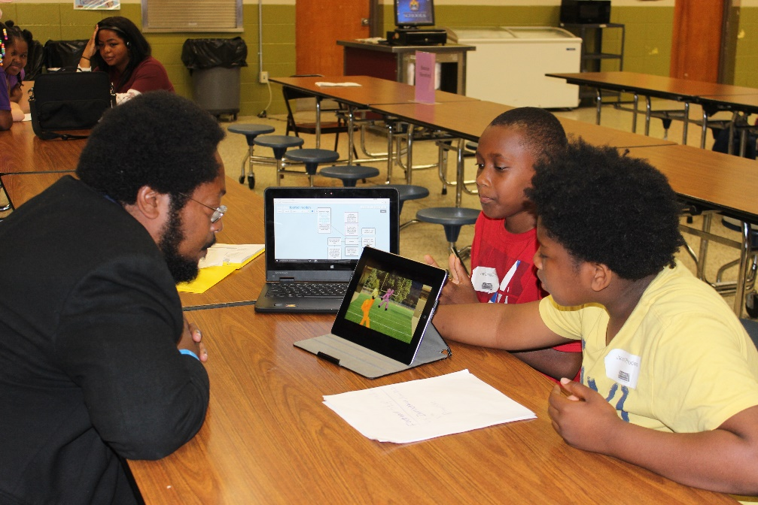
Serve as the Connector for Families and the Community (additional examples)

Slide 8
Having Multiple Ways to Connect With The Community Is One Of The
District’s Community Engagement Strategies
CONTACT US (district website):
Trending Topics:
Registration Paperwork
Student Enrollment
School Calendar
Employment
Transcripts
School Zones
Follow us on:
Facebook
Twitter
Periscope
Instagram
ETV
www.huntsvillecityschools.org
Huntsville Council of PTA: website/FB page

Slide 9
Thank You!!!!

