Slide 1
Emergency preparedness/ school safety
Jessica L. Covington
Risk/Safety Manager
Huntsville City Schools
July 22, 2017

Slide 2
Emergency Preparedness and School Safety Topics
Student Participation in School Safety
Emergency Response Resources
Parent Roles During an Emergency

Slide 3
Student Participation in School Safety
Monthly Emergency Response Drills
Every month, each school conducts an emergency response drill.
These drills include practicing emergency responses to fires, severe weather, intruder, etc.
Administration communicates the threat and the threat response reasoning to the students. Our goal is for students to take emergency response information home and to the future workplace.
When feasible, drills are observed by central office staff.
All are evaluated by school administration and school safety coordinator.

Slide 4
Emergency Response Resources
Huntsville City School website
Emergency Information for Parents located under the Risk Management Department.
Emergency Flipcharts
Located in every class room, and other areas of congregation in the school, along with an evacuation/severe weather refuge maps.

Slide 5
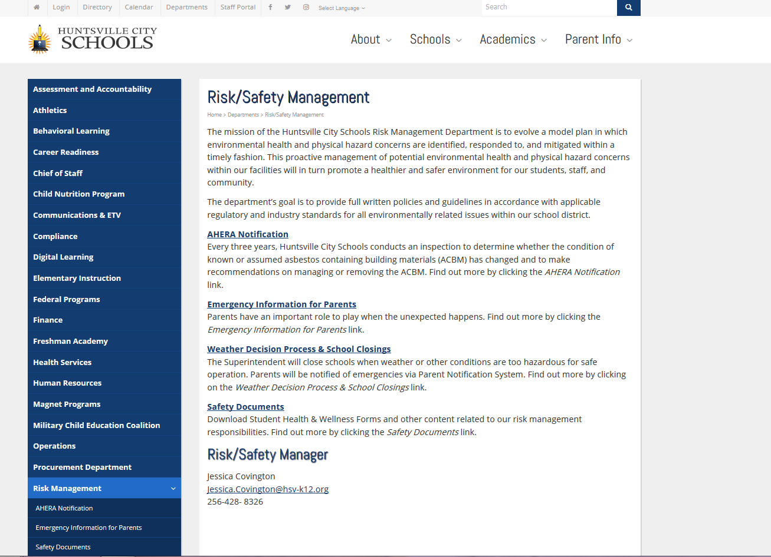

Slide 6
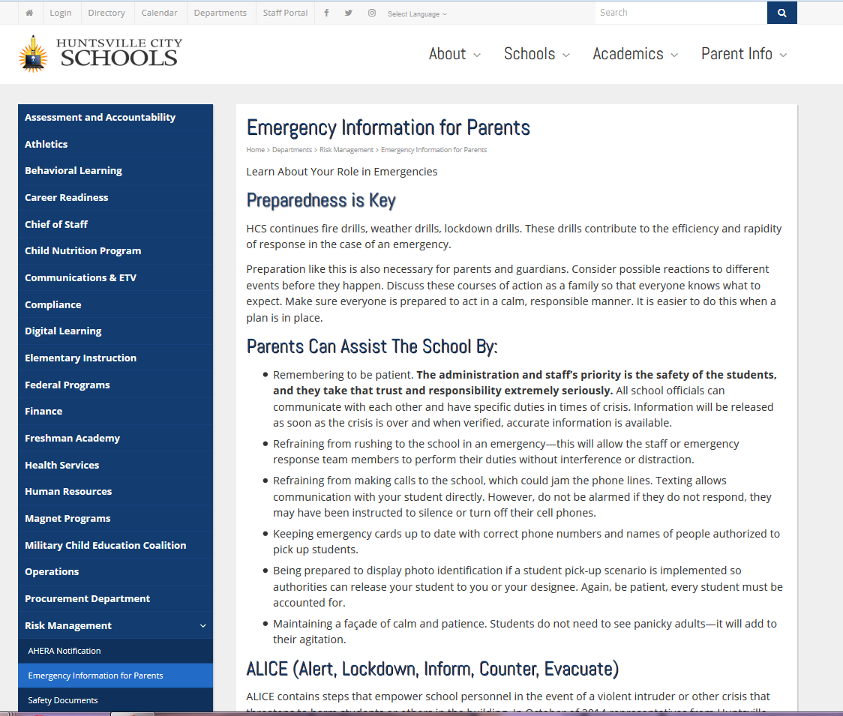

Slide 7
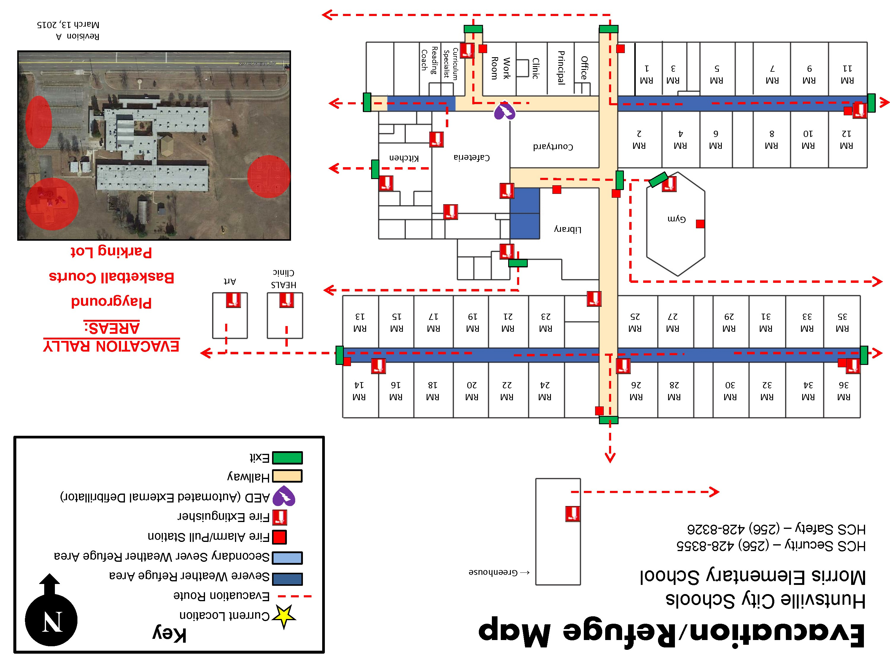

Slide 8
Parent Roles During an Emergency
Be patient.
Refrain from rushing to the school in an emergency – this will allow the staff or emergency response team members to perform their duties without interference or distraction.
Refrain from making calls to the school, which could jam the phone lines. Texting allows communication with student directly. However, do not be alarmed if they do not respond.
Keep emergency cards up to date with correct phone numbers and names of people authorized to pick up students.
Remain calm.

Slide 9
Risk/safety Management department
256-428-8326
Jessica.Covington@hsv-k12.org

