Slide 1
Welcome to the
Huntsville Council of PTAs
Awards Banquet
2021
-2022

Slide 2
PTA Mission
Our mission is to make every child’s potential a reality by engaging and empowering families and communities to advocate for all children.

Slide 3
Six National PTA Standards
Welcoming All Families
Communicating Effectively
Supporting Student Success
Speaking Up for Every Child
Sharing Power
Collaborating with the Community

Slide 4
Presentation of Colors
and
Pledge of Allegiance
Cub Scout Pack 906
Davis Carr
Mitchell Carr
Zion Similton
Khaleb Cawthorn
Grayson Murphy

Slide 5
Invocation
by
Debra West

Slide 6
DINNER
Garden Salad
Chicken Teriyaki
Beef Tip & Rice
Garlic Mashed Potatoes
Vegetable Medley
Fresh Baked Rolls
Sweet/Unsweet Iced Tea & Water
German Chocolate Cake

Slide 7
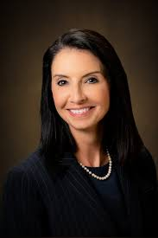
Opening Remarks
Superintendent
Christie Finley

Slide 8
Year in Review

Slide 9
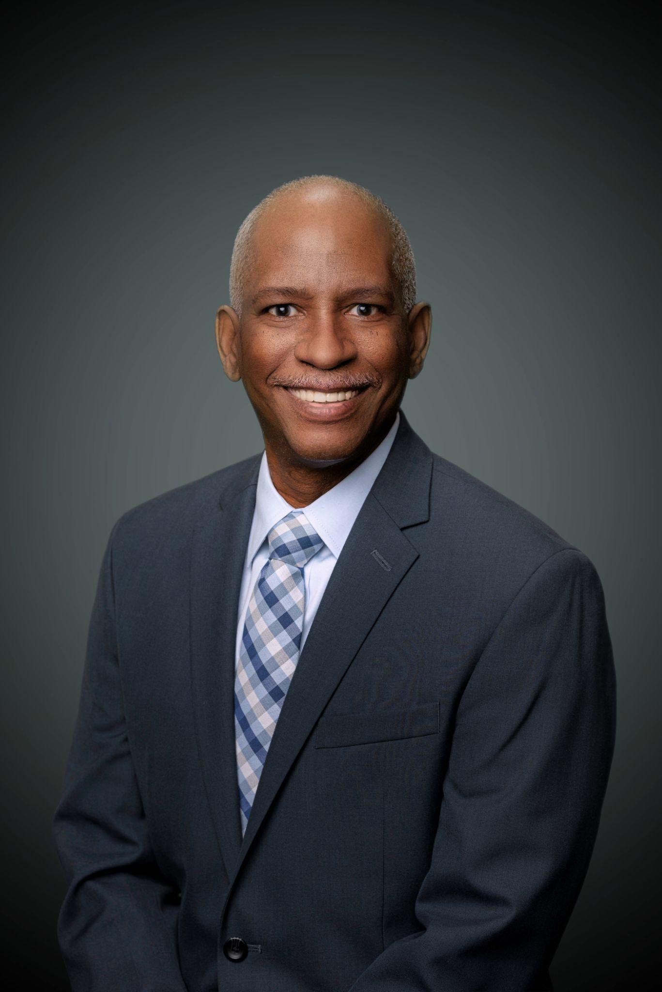
Huntsville City Council Member
John Meredith

Slide 10
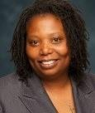
Guest Speaker
Dr. Erica Hopkins

Slide 11
Scholarship Recipients
Congratulations!

Slide 12
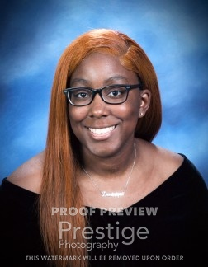
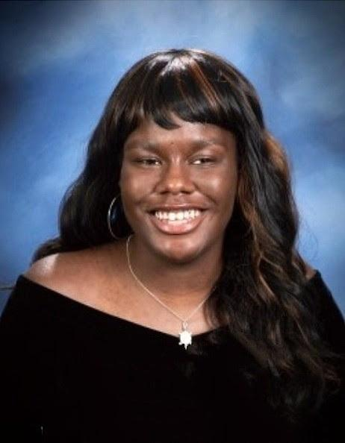
Columbia High School
Scholarship Recipients
Dominique Davis Salaam Nahasi
Undecided

Slide 13
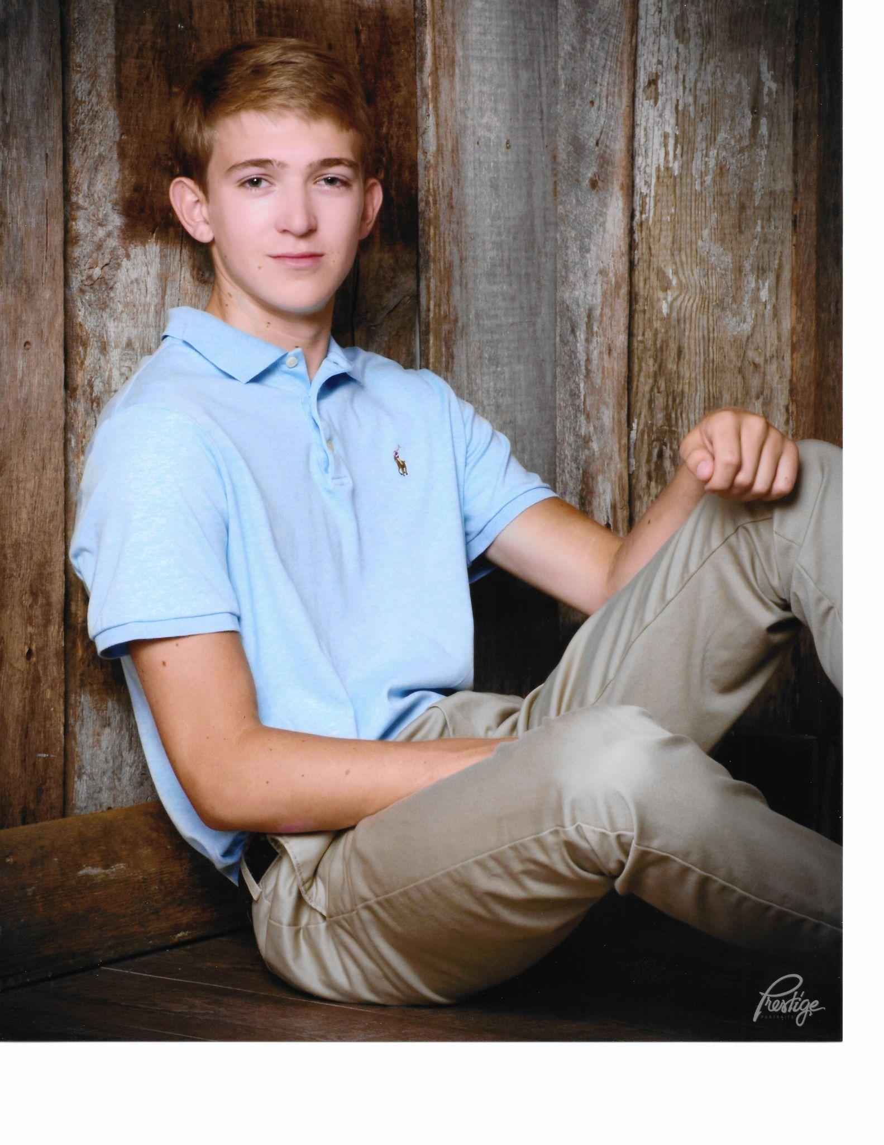
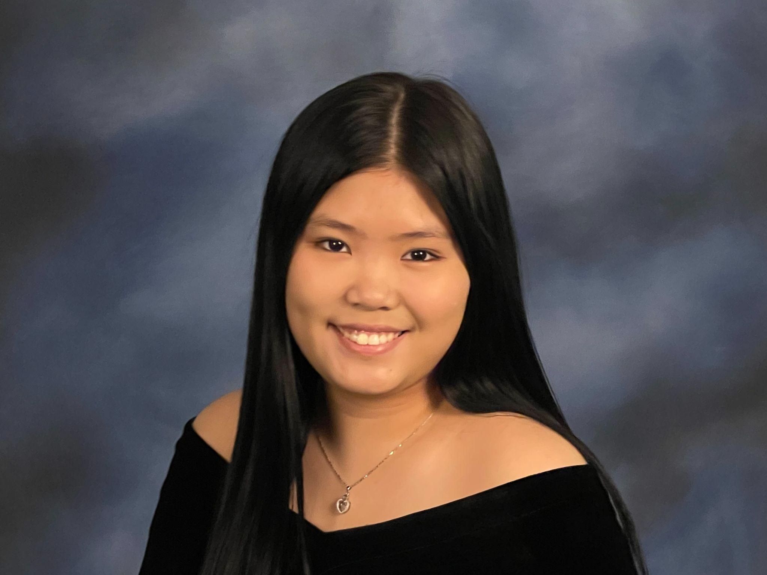
Grissom High School
Scholarship Recipients
Evan Segrest
Ashley Lin

Slide 14
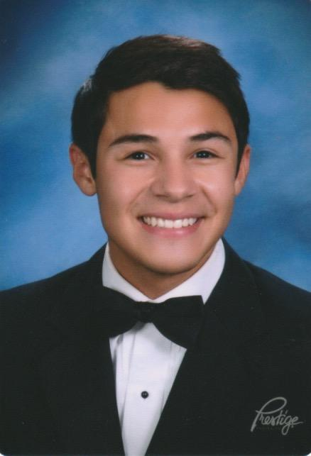
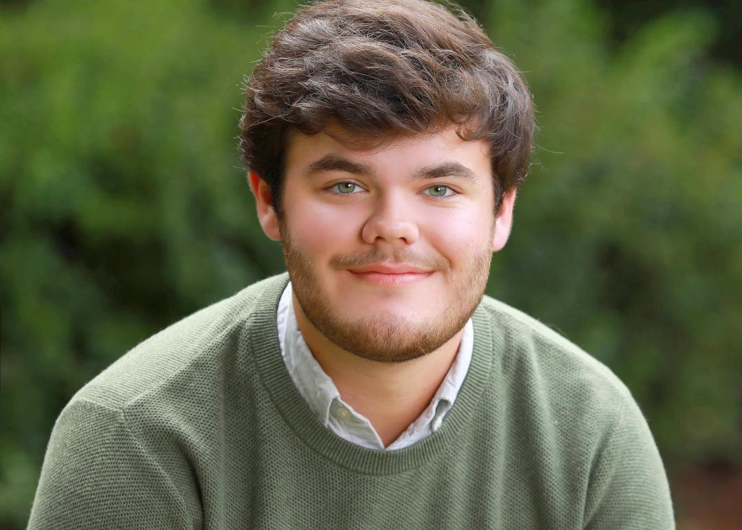
Huntsville High School
Scholarship Recipients
Tate Colebaugh Caden Jackson

Slide 15
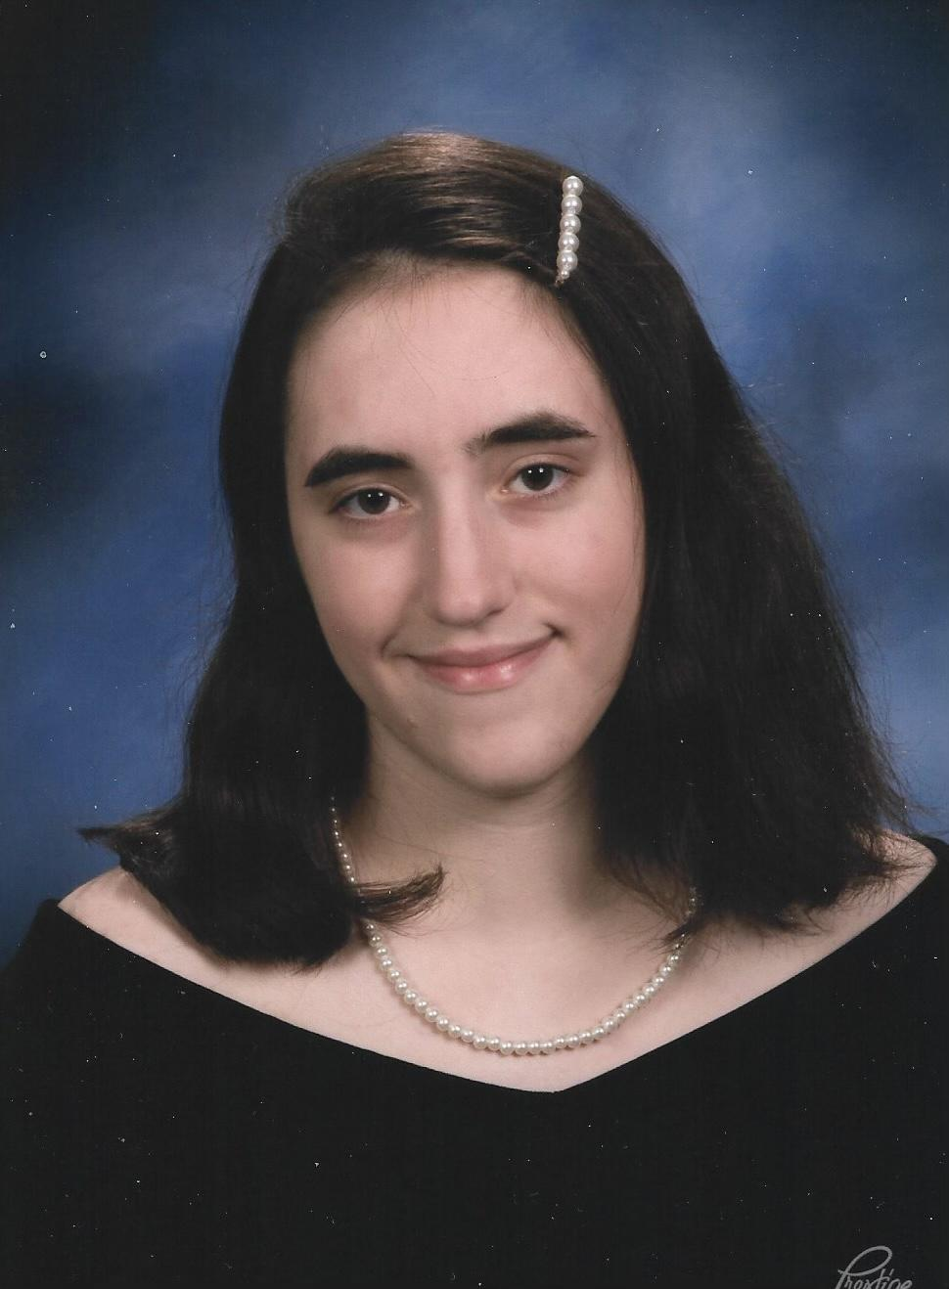
Lee High School
Scholarship Recipient
Shea Patrick

Slide 16
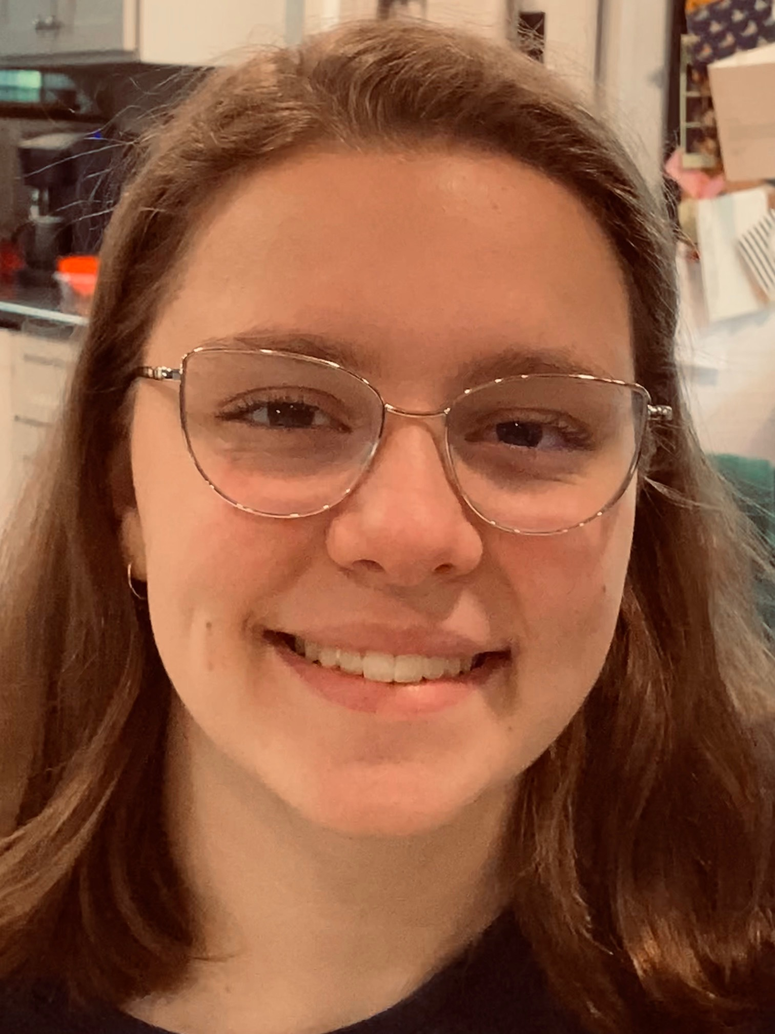
New Century High School
Scholarship Recipient
Mary Phillips

Slide 17
Huntsville Council of PTAs
Grant Recipients
Whitesburg PTA - Playground Garden ($500)
McDonnell Elementary PTA - Family Math Night ($650)
Ridgecrest Elementary PTA - Fighting the Summer Reading Slump ($1,000)
Providence Elementary PTA - Initial Fill of Book Vending Machine ($1,000)

Slide 18
Educator Awards
Congratulations!

Slide 19
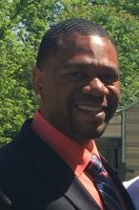
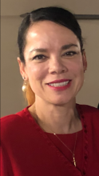
Outstanding Administrator Award
Highlands Elementary School
Dr. Patsey Thomas
Hampton Cove Middle School
Mr. Miguel Stricklen

Slide 20
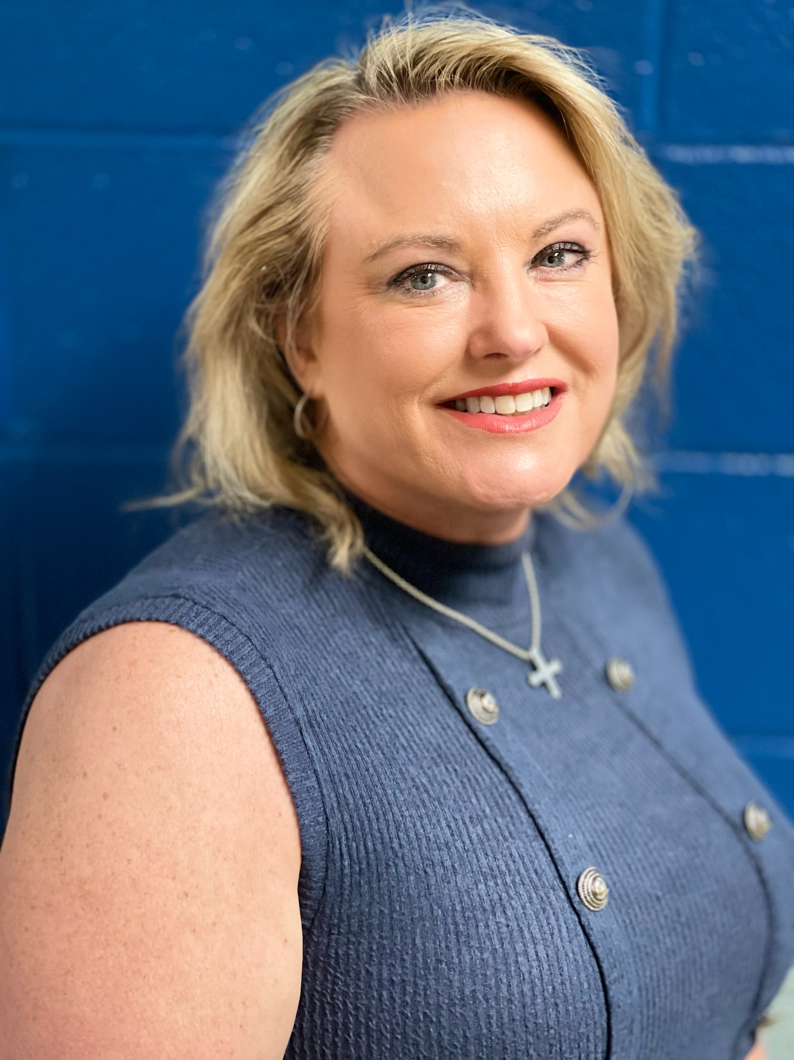
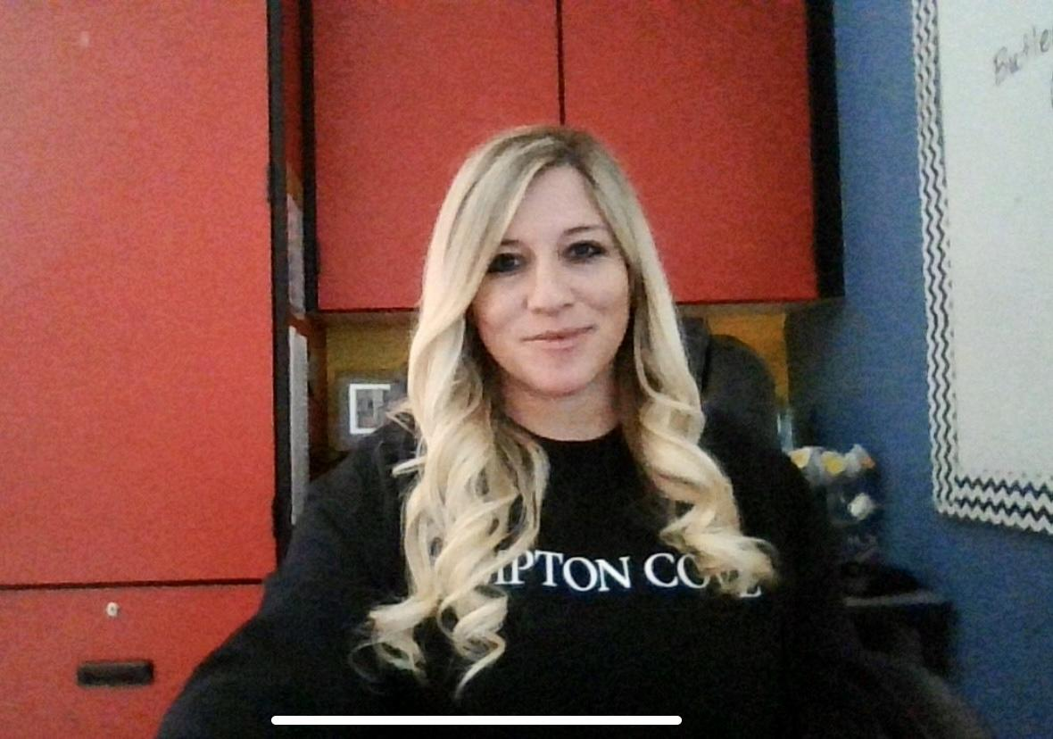
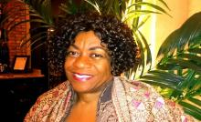
Outstanding Teacher Award
Challenger Elementary School
Lorri Stricklen
Hampton Cove Middle School
Briana Butler
Mae Jemison High School
Estefania Howell

Slide 21
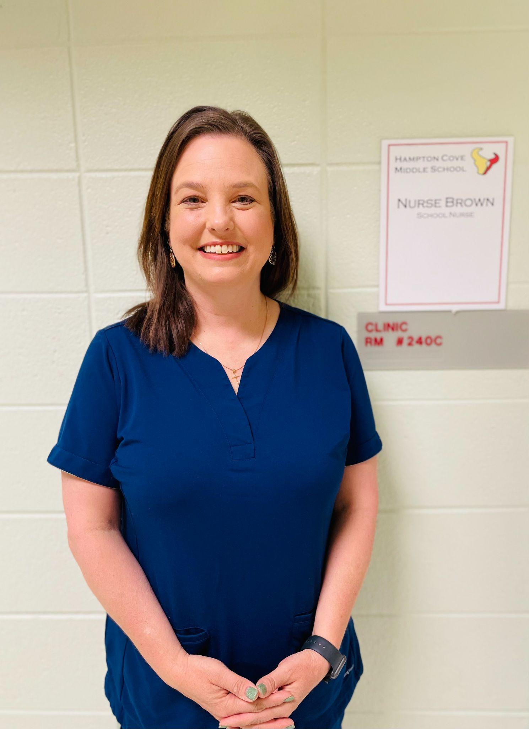
Outstanding Support Staff Award
Congratulations!
Mae Jemison High School
Jean Matthews
Hampton Cove Middle School
Christine Brown

Slide 22
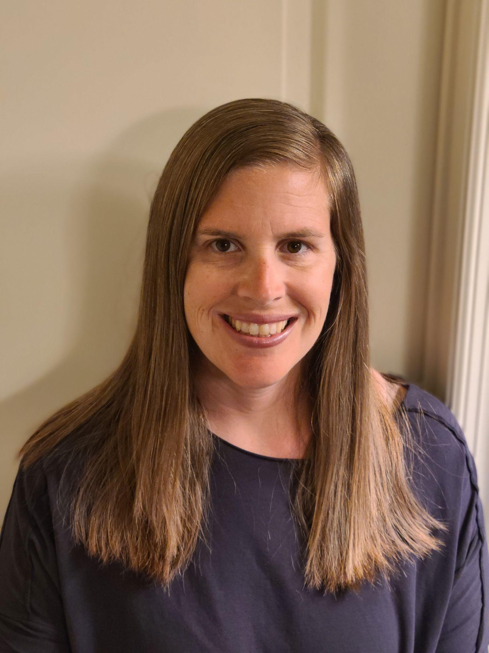
Outstanding Volunteer Award
Challenger Elementary School
Michelle Salehi
ASFL Middle School
Latoya Adams

Slide 23
ALPTA Educator Awards
Outstanding Administrator
Elementary School Division
Dr. Michelle Wallace
Challenger Elementary School
Middle School Division
Miguel Stricklen
Hampton Cove Middle School
Outstanding Teacher
Middle School Division
Briana Butler
Hampton Cove Middle School
High School Division
Estefania Howell
Mae Jemison High School
Outstanding Support Staff
Elementary School Division
Joan Alverson
Martin Luther King, Jr. Elementary School
Middle School Division
Christine Brown
Hampton Cove Middle School
High School Division
Jean Matthews
Mae Jemison High School

Slide 24
Family School-Partnership Awards
Congratulations!

Slide 25
Family-School Partnership Awards
Welcoming All Families
Elementary Division – Jones Valley Elementary School PTA
Communicating Effectively
Elementary Division - Jones Valley Elementary School PTA
Support Student Success
Elementary Division - Jones Valley Elementary School PTA

Slide 26
Family-School Partnership Awards
Speaking Up For Every Child
Elementary Division - Ridgecrest Elementary School PTA
Collaborating With The Community
Elementary School Division - Jones Valley Elementary School PTA

Slide 27
ALPTA Family-School Partnership Awards
Communicating Effectively
High School Division
Huntsville High School
Supporting Student Success
Elementary Division
Jones Valley Elementary School
Speaking Up for Every Child
Elementary Division
Jones Valley Elementary School
Collaborating with the Community
Elementary Division
Jones Valley Elementary School

Slide 28
Congratulations
to
Carlie Foster
&
John Isaac Segrest
for achieving 1st place in the
ALPTA Reflections Program Competition
They advanced to the National PTA Reflections Competition!
Winners will be announced 5/1/22

Slide 29
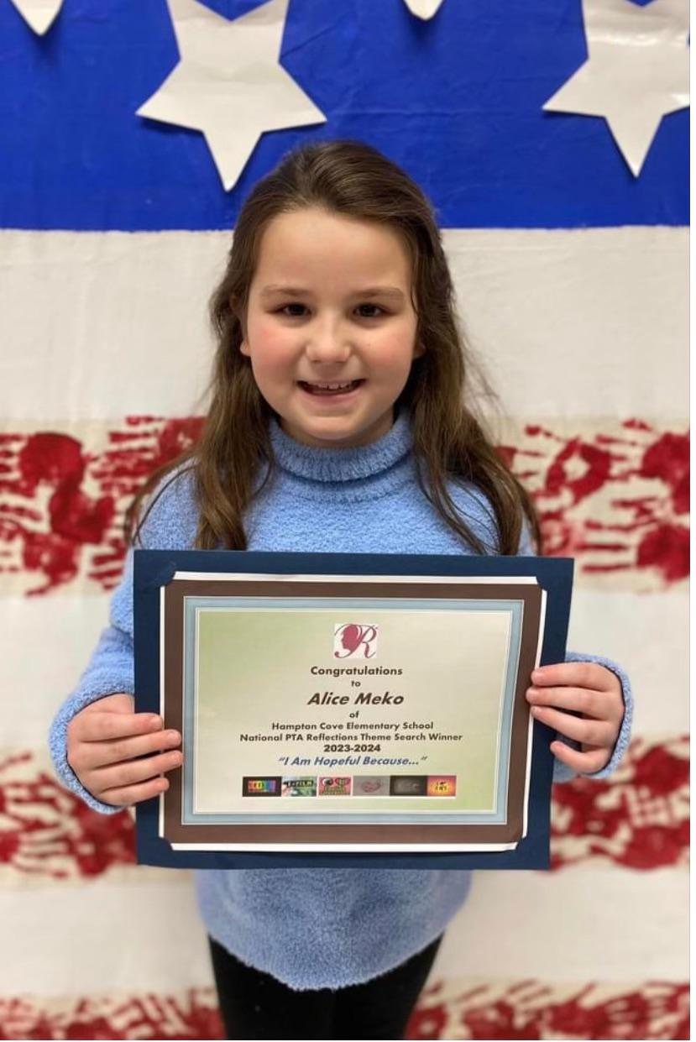
Congratulations
to
Alice Meko
National PTA Annual Theme Search Contest Winner!
2023-2024 Reflections Program Theme
“I Am Hopeful Because…”

Slide 30
Congratulations
to the
2022 ALPTA Diversity Writing Contest Winners
2nd place Carlie Foster - 1st grade - Jones Valley Elementary School
1st place - Mikayla King - 4th grade - Goldsmith-Schiffman Elementary School
2nd place - Roxie Foster - 8th grade - Huntsville Jr. High School
3rd place - Qloe Foster - 6th grade - Jones Valley Elementary School

Slide 31
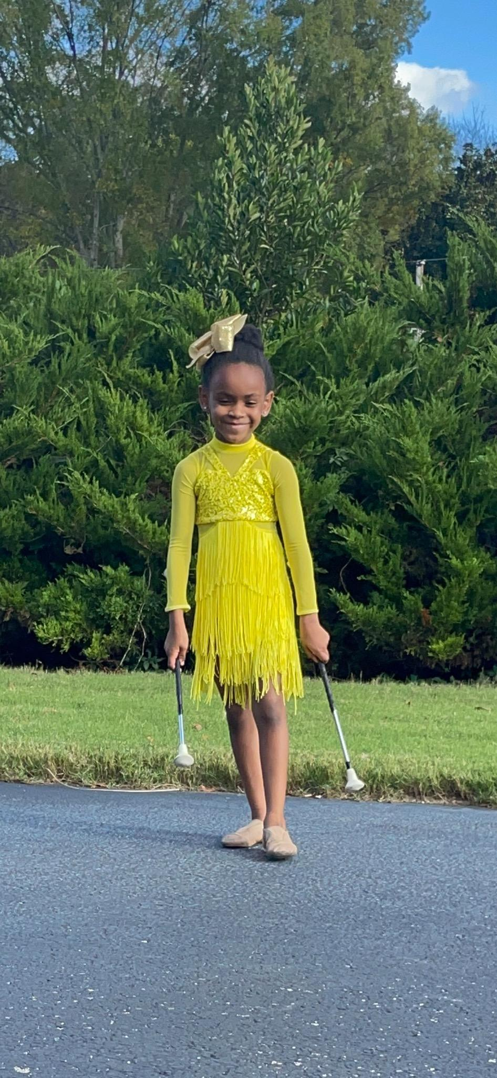
Congratulations
to
Carlie Foster!
ALPTA Diversity Writing Contest Winner
2nd place Carlie Foster - 1st grade - Jones Valley Elementary School

Slide 32
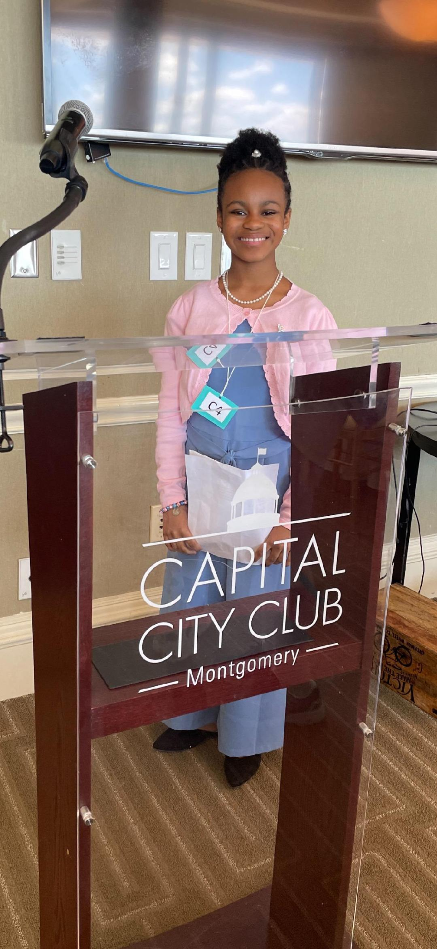
Congratulations
to
Qloe Foster!
ALPTA Diversity Writing Contest Winner
3rd place Qloe Foster - 6th grade - Jones Valley Elementary School

Slide 33
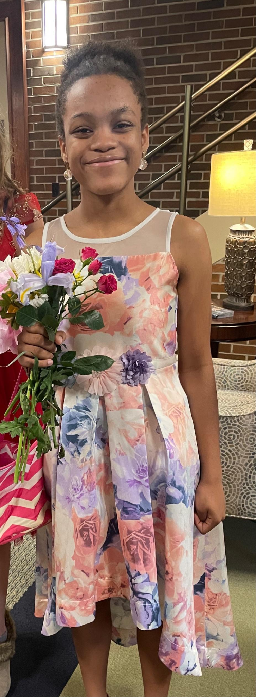
Congratulations
to
Roxie Foster!
ALPTA Diversity Writing Contest Winner
2nd place Roxie Foster - 8th grade - Huntsville Jr. High School

Slide 34
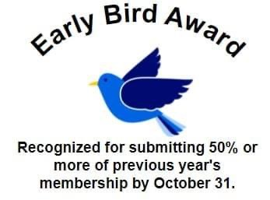
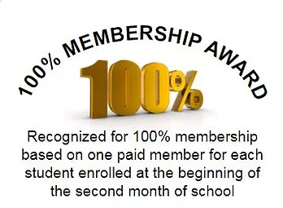
Alabama PTA Membership Awards
2021-2022

Slide 35
ALPTA Membership Awards
Outstanding Membership Award
Division I
Monte Sano Elementary School PTA
1-300 Students
Division III
Hampton Cove Elementary School PTA
601-900 Students
Division IV
Goldsmith Schiffman Elementary School PTA
901-1200 Students
Division V
Huntsville High School PTSA
1201-up Students
100% Consecutive Years Award
Monte Sano Elementary School PTA
39 Years

Slide 36
Congratulations
to the
2022 - 2023
HCPTA Executive Committee Officers
President - Deanna Patton
VP Leadership Development - Jennifer Pearson
VP Programs - Jovonne Foster
VP Membership - Laura Frame
VP Legislative Affairs - Vacant
Treasurer - Vacant
Secretary - Delores Baker

Slide 37
Thank you for attending the
Huntsville Council of PTAs
Awards Banquet!
2021
-2022

