Slide 1
Huntsville Council of PTAs
Virtual Awards Celebration
2020
-2021

Slide 2
WELCOME!

Slide 3
PTA Mission
Our mission is to make every child’s potential a reality by engaging and empowering families and communities to advocate for all children.

Slide 4
6 National Standards
Welcoming All Families
Communicating Effectively
Supporting Student Success
Speaking Up for Every Child
Sharing Power
Collaborating with the Community

Slide 5
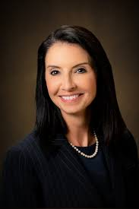
Opening Remarks
Superintendent
Christie Finley

Slide 6
Year in
Review

Slide 7
Embed Video Here

Slide 8
CONGRATULATIONS
to
Angela Smith!
Elementary Teacher of the Year

Slide 9
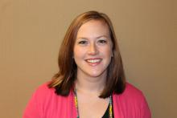
CONGRATULATIONS
to
Kierstan Bell!
Secondary Teacher of the Year

Slide 10
Family School-Partnership Awards
Congratulations!

Slide 11
Family-School Partnership Awards
Welcoming All Families
Elementary Division – Mountain Gap Elementary PTA
High School Division – New Century Technology High School PTSA
Communicating Effectively
Elementary Division - Jones Valley Elementary School PTA
High School Division - New Century Technology High School PTSA
Support Student Success
Elementary Division - Jones Valley Elementary PTA
High School Division - New Century Technology High School PTSA

Slide 12
Family-School Partnership Awards
Speaking Up For Every Child
Elementary Division - Jones Valley Elementary School PTA
High School Division - New Century Technology High School PTSA
Sharing Power
Elementary Division - Jones Valley Elementary School PTA
High School Division - New Century Technology High School PTSA
Collaborating With The Community
Elementary School Division - Jones Valley Elementary School PTA
Middle School Division - Huntsville Jr. High School PTSA
High School Division - Huntsville High School PTSA

Slide 13
AL State PTA Family-School Partnership Awards
Welcoming All Families
Elementary Division
Mountain Gap Elementary School
High School Division New Century Technology High School
Communicating Effectively
Elementary Division
Jones Valley Elementary School
High School Division New Century Technology High School
Supporting Student Success
Elementary Division
Jones Valley Elementary School
High School Division
New Century Technology High School
Speaking Up for Every Child
Elementary Division
Jones Valley Elementary School
High School Division
New Century Technology High School
Sharing Power
Elementary Division
Jones Valley Elementary School
High School Division
New Century Technology High School
Collaborating with the Community
Elementary Division
Jones Valley Elementary School
Middle/Jr. High School Division Mountain Gap Middle School
High School Division
Huntsville High School

Slide 14
Educator Awards
Congratulations!

Slide 15
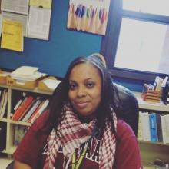
Outstanding Administrator Awards
Highlands Elementary School
Hovet Dixon
Mae Jemison High School
Dr. Demetris Harris-Leverette

Slide 16
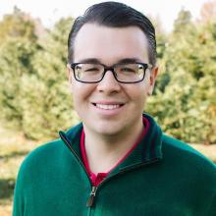
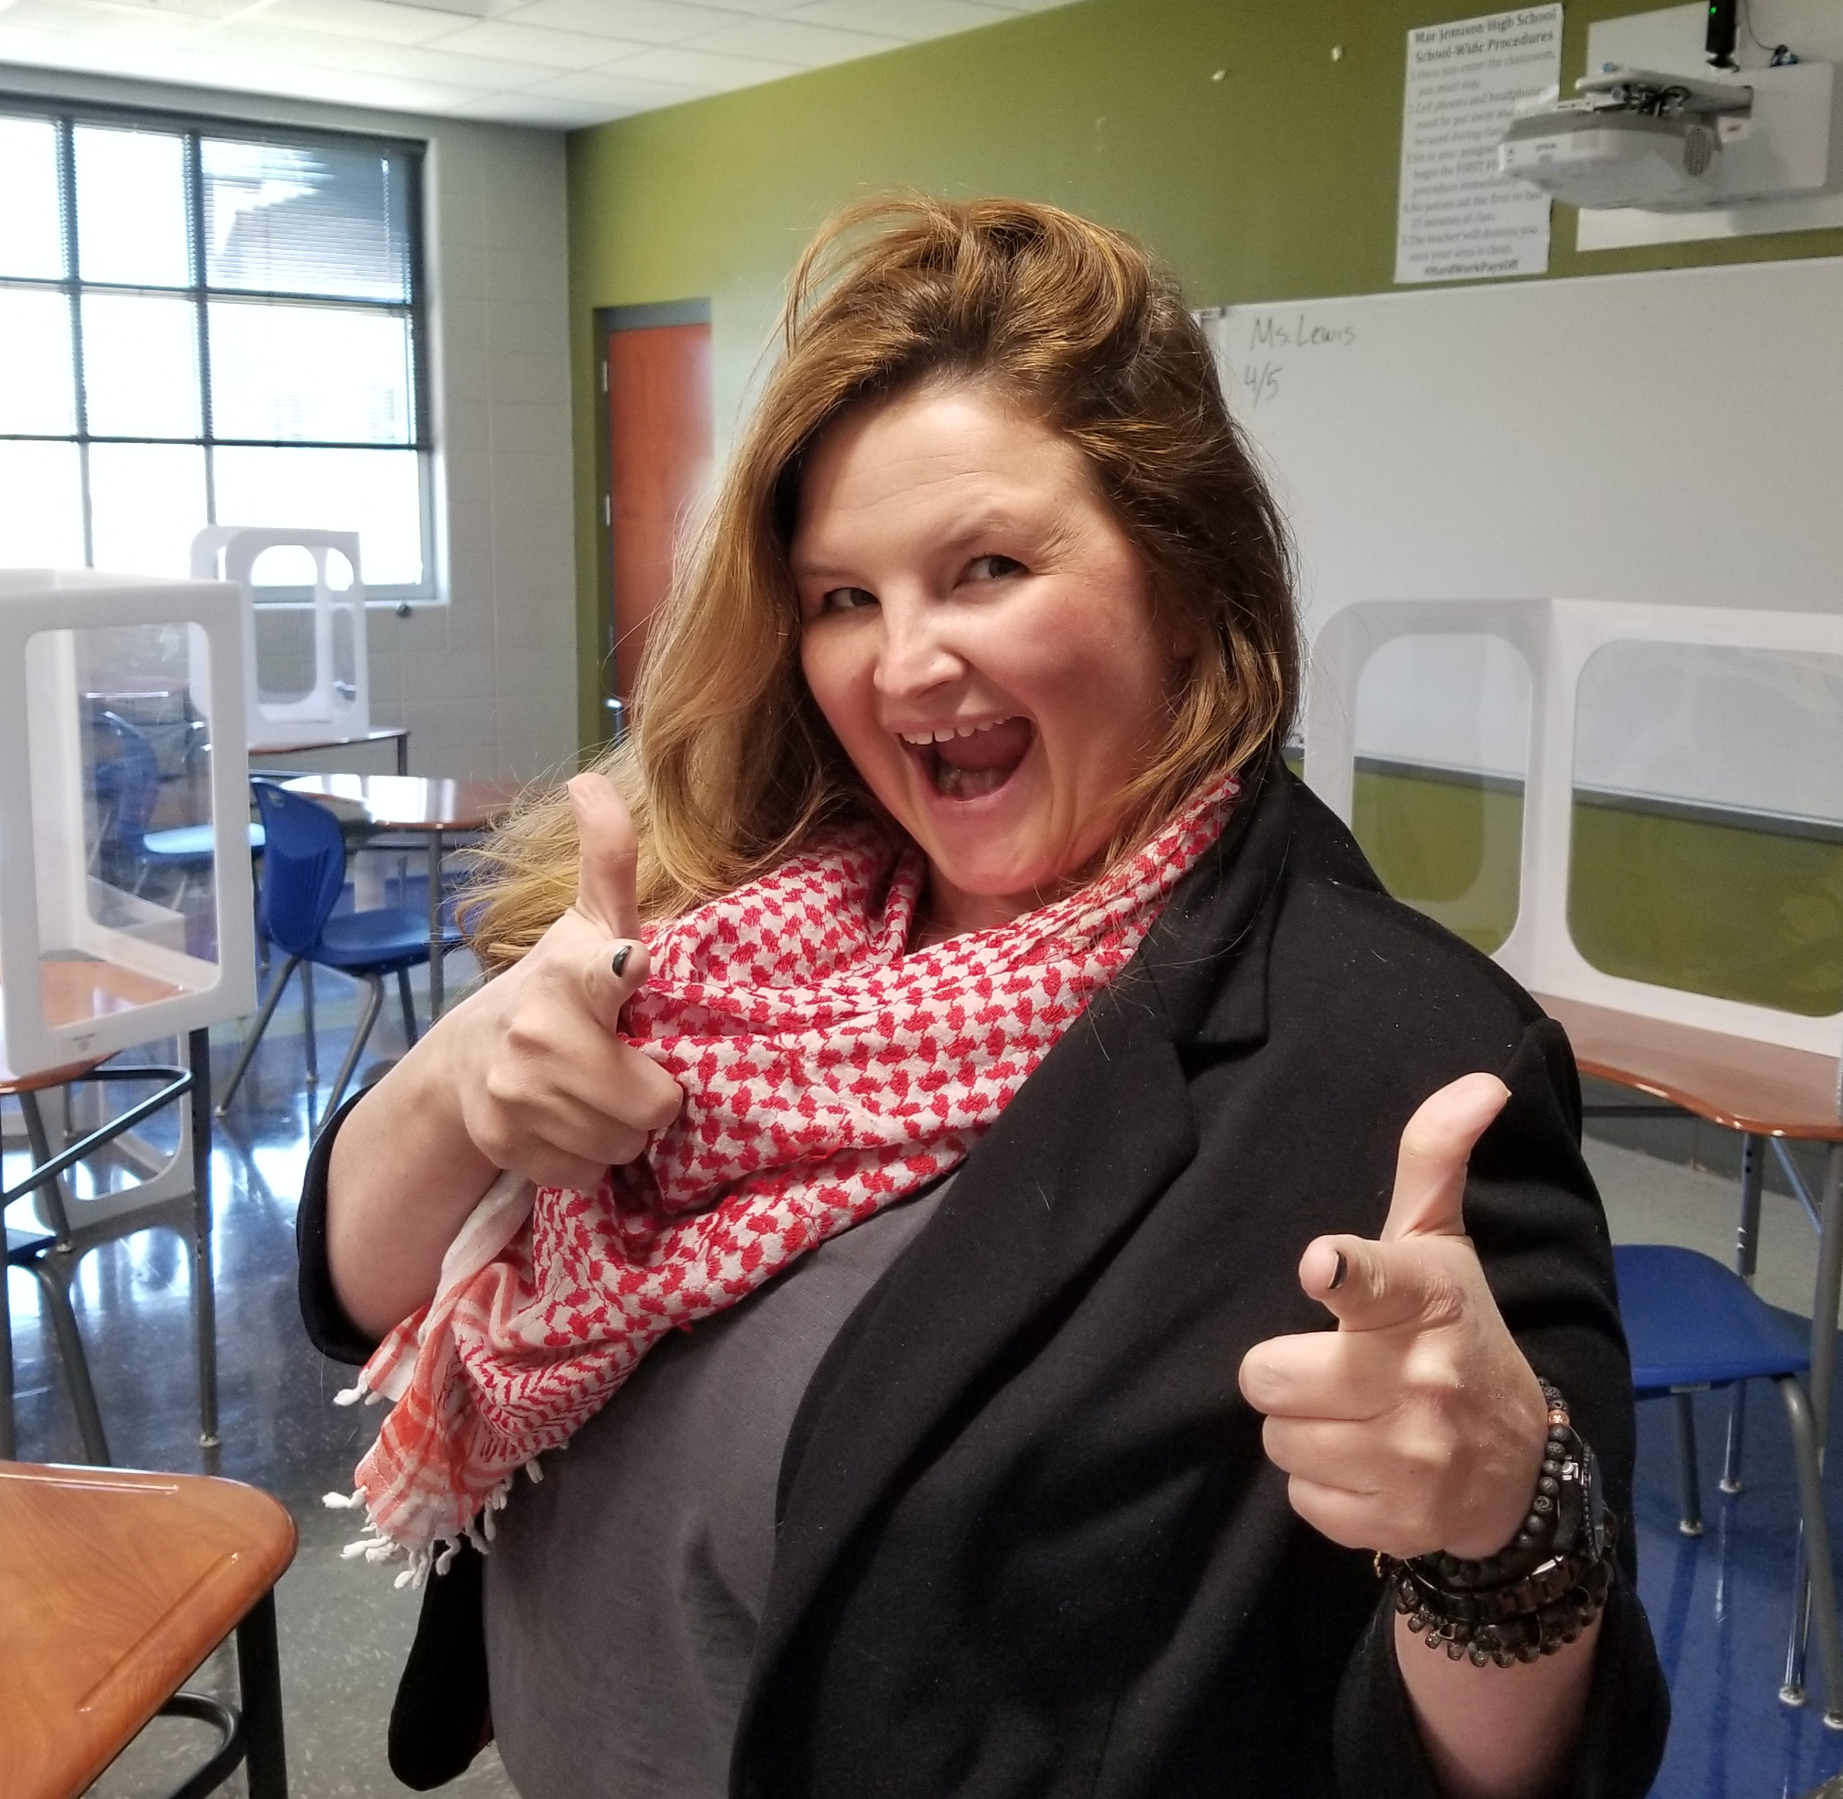
Outstanding Teacher Award Recipients
Challenger Middle School
Andrew Sivak
Mae Jemison High School Adriene Weller

Slide 17
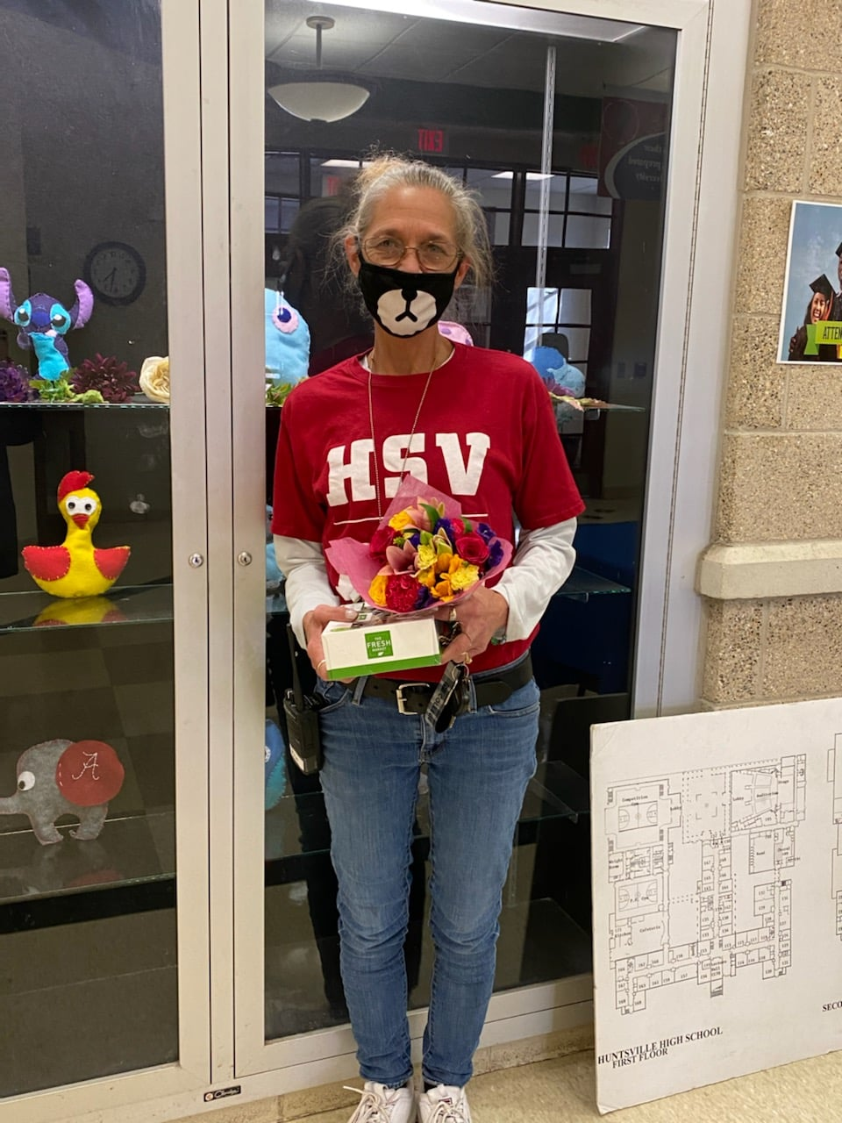
Outstanding Support Staff Award
Huntsville High School
Kim Ferguson

Slide 18
Outstanding Volunteer Award
Challenger Elementary School
Andrea Alvarez Hatfield

Slide 19
AL State PTA Educator Awards
Outstanding Administrator
High School Division
Dr. Demetris Harris-Leverette Jemison High School
Outstanding Teacher
High School Division
James Chris Carter
Lee High School
Outstanding Support Staff
High School Division
Crystal Carter
Jemison High School

Slide 20
Huntsville Council of PTAS
$500 Grant Recipients
Jones Valley Elementary PTA - Read & Review Little Library
Martin Luther King Elementary PTA - Outdoor Classroom
Mountain Gap Middle School PTA - Robotics Class Upgrade
New Century High School PTA - Yard Signs
Providence Elementary PTA - Health & Wellness Reading

Slide 21
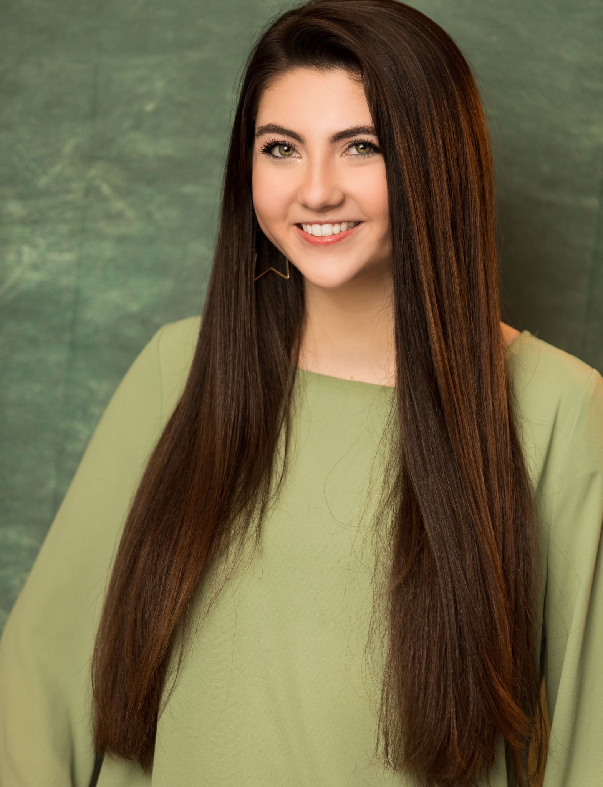
Emma Weisberg
Congratulations!

Slide 22
Scholarship Recipients
Congratulations!

Slide 23
Columbia High School
Scholarship Recipient
DaQuarrius Poole

Slide 24
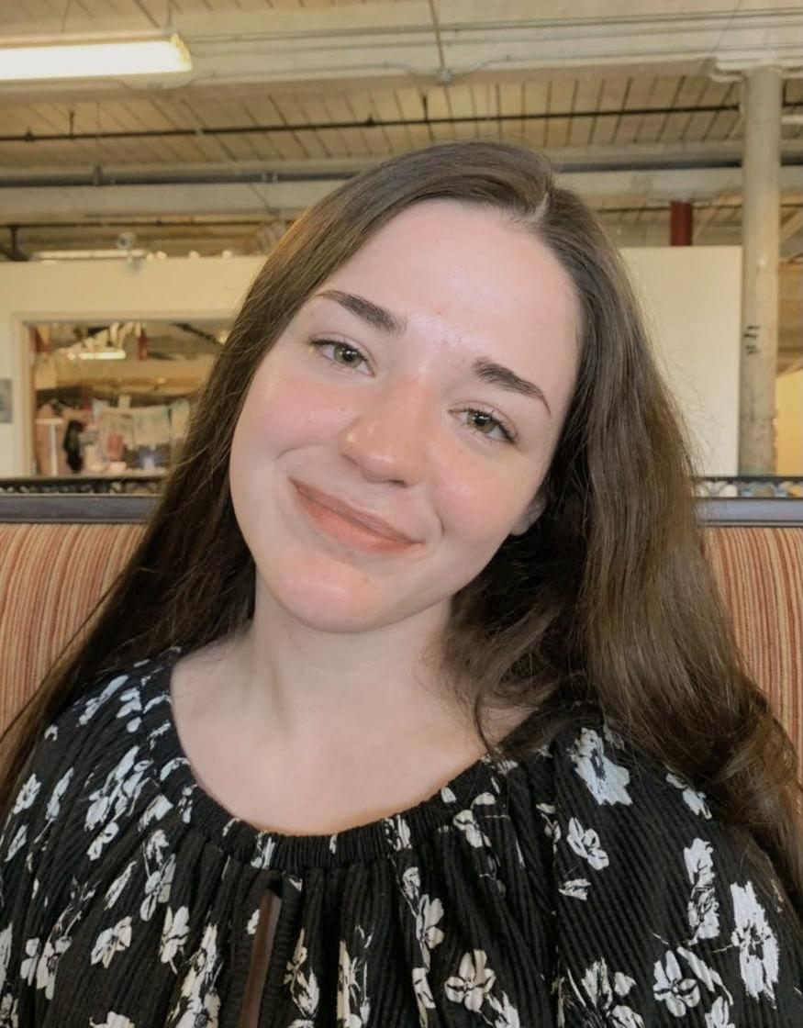
Grissom High School
Scholarship Recipients
Brendan Bechtel Mia Esposito

Slide 25
Huntsville High School
Scholarship Recipients
Courtney Robertson Emma Weisberg

Slide 26
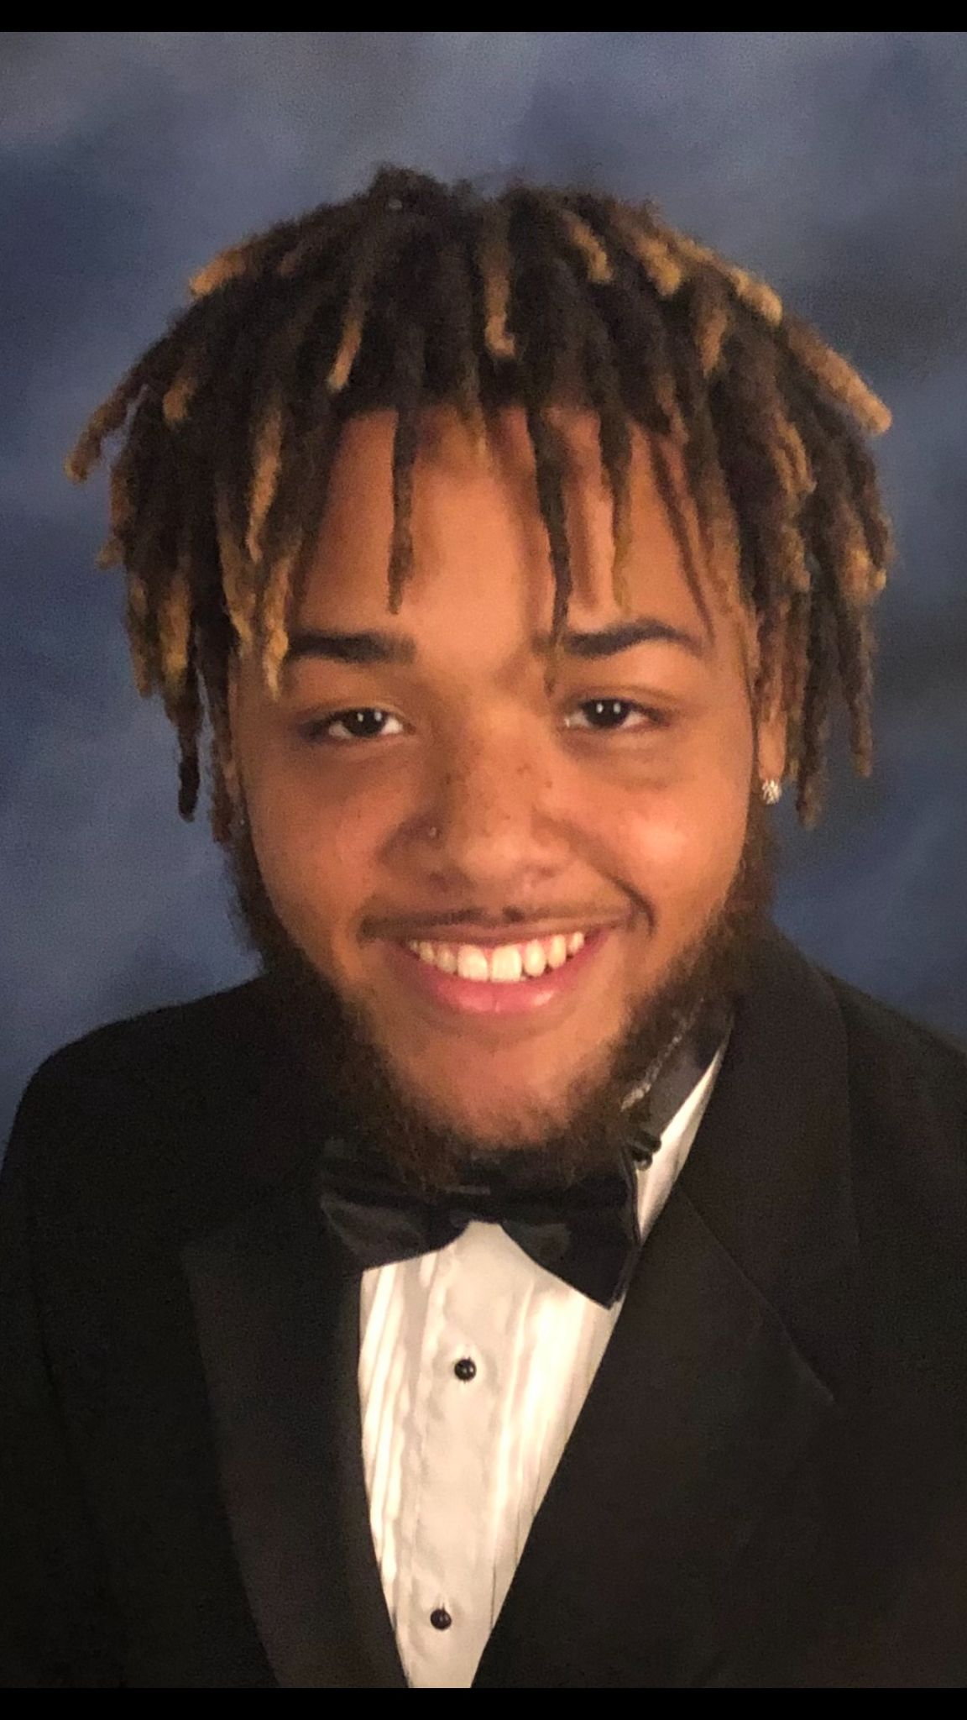
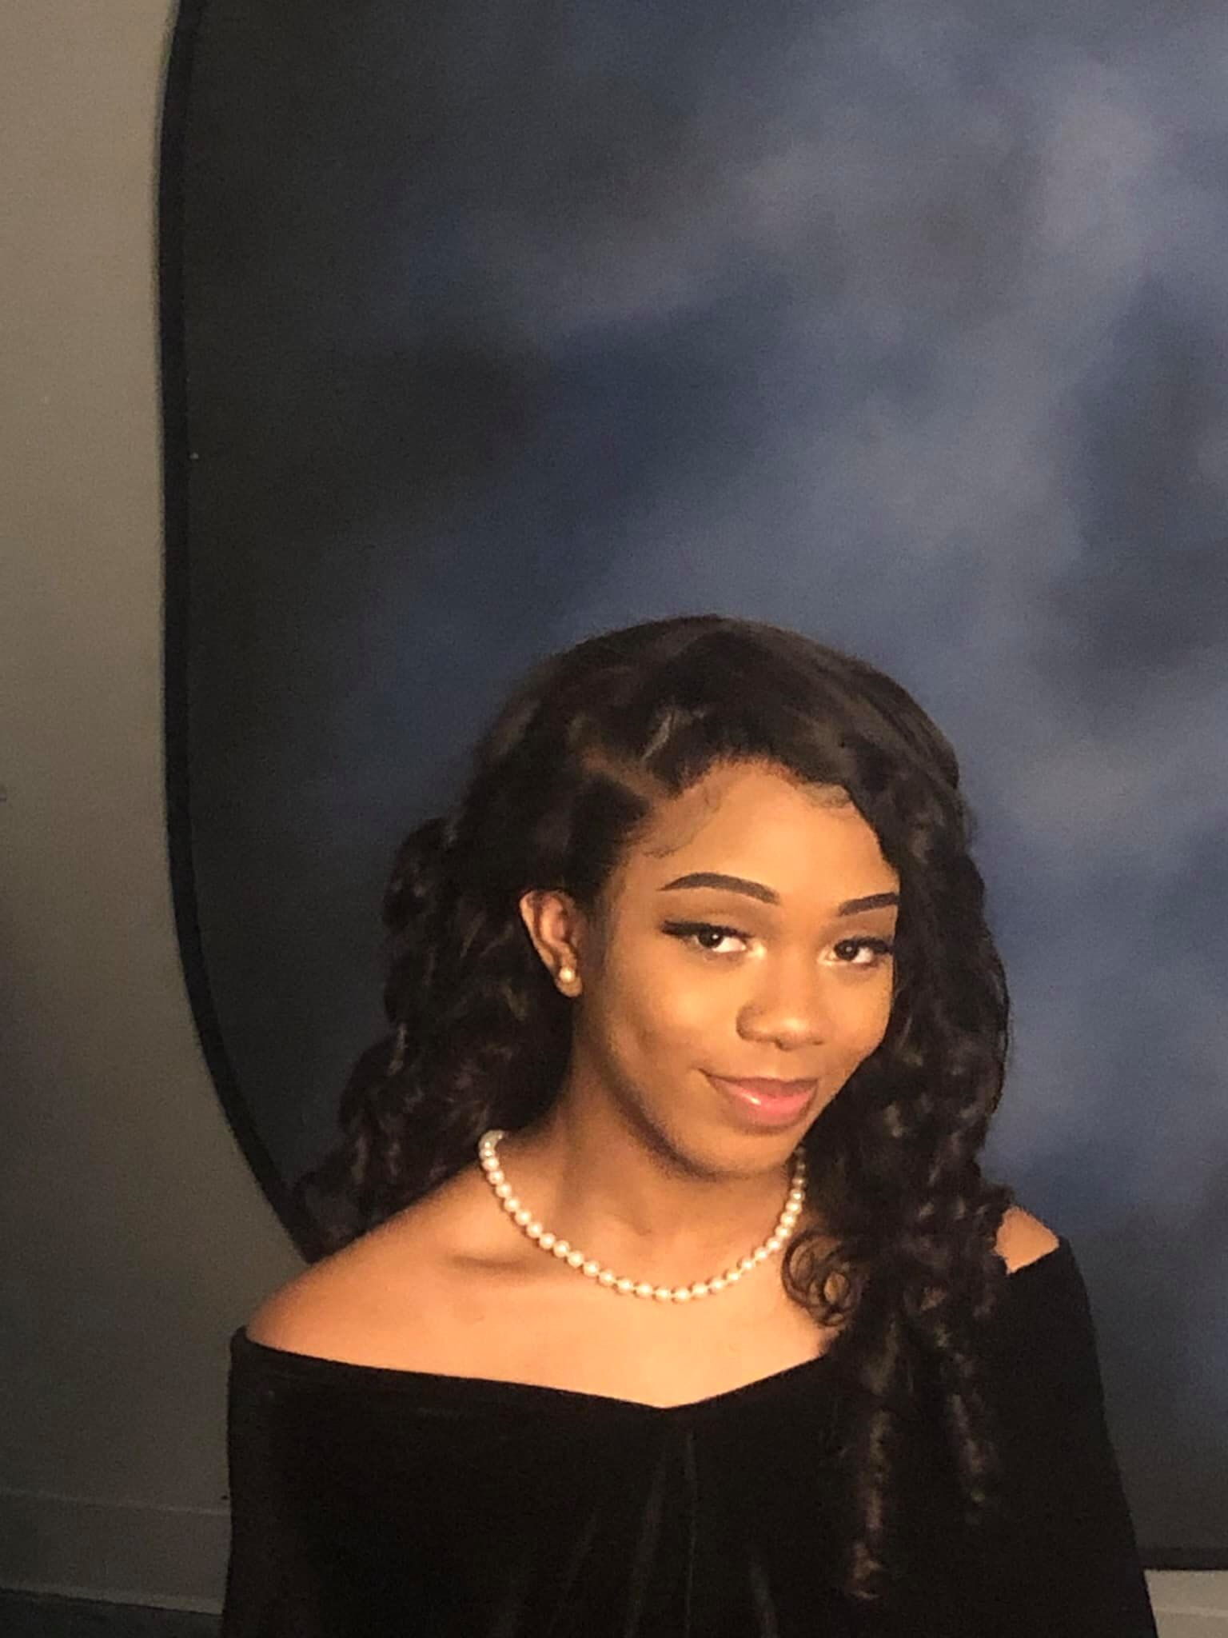
Lee High School
Scholarship Recipients
Nicholas Fields Serenity Turner

Slide 27
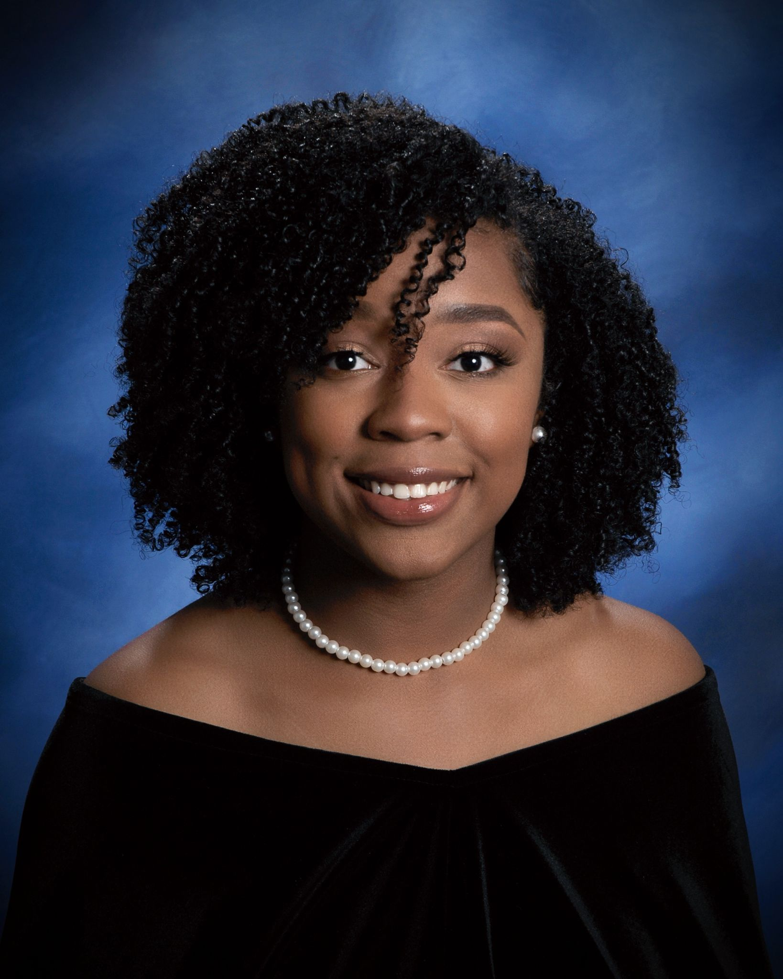
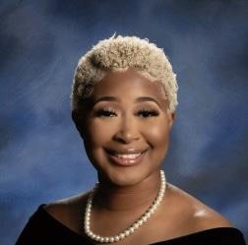
Jemison High School
Scholarship Recipients
Makenzie Friend Shakiya Friend
Undecided

Slide 28
Alabama PTA Membership Awards
2020-2021
Golden Apple Recipients:
Challenger Elementary School PTA
Columbia Elementary School PTA
Discovery Middle School PTA
Dr. Mae Jemison HS PTA
Hampton Cove Elementary School PTA
Hampton Cove Middle School PTA
Heritage Elementary School PTA
Highlands Elementary School PTA
Huntsville Junior High School PTA
J.E. Williams Elementary PTA
J.E. Williams Middle School - AGTPTA
Monte Sano Elementary PTA
Mountain Gap PTA
Ridgecrest Elementary PTA
Sonnie Hereford PTA
Weatherly Heights Elementary PTA
Early Bird Recipients:
Challenger Elementary School PTA
Discovery Middle School PTA
Dr. Mae Jemison HS PTA
Hampton Cove Middle School PTA
Heritage Elementary School PTA
Highlands Elementary School PTA
Huntsville Junior High School PTA
Jones Valley PTA
Monte Sano Elementary PTA
Mountain Gap PTA
New Century Technology High School PTA
Ridgecrest Elementary PTA
Sonnie Hereford PTA

Slide 29
ALPTA Reflections Winners
Arts/Category Division Name PTA UNIT NAME
Visual Arts Primary Carlie Foster Jones Valley Elementary School PTA
Visual Arts Intermediate Emma Todd Goldsmith Schiffman Elementary School PTA
Visual Arts Intermediate Eris Seay Challenger Elementary School PTA
Visual Arts Middle School Brynn Crossley Huntsville Jr. High School PTSA
Visual Arts High School Sophie Rabban Huntsville High School PTSA
Photography Primary Williamson Wood Jones Valley Elementary School PTA
Photography Primary Harvey Mixson Roger B. Chaffee Elementary School PTA
Photography Intermediate James Gardner Hampton Cove Elementary School PTA
Photography Middle Laurel Howard Mountain Gap Middle School PTSA
Photography Middle Miranda Moore Hampton Cove Middle School PTSA
Photography High School Emma Lang Virgil Grissom High School PTSA

Slide 30
ALPTA Reflections Winners
Arts/Category Division Name PTA Unit Name
Dance Choreography Primary Carlie Foster Jones Valley Elementary School PTA
Dance Choreography Middle Emily Osmer Hampton Cove Middle School PTSA
Dance Choreography Middle Rylee Satterfield Academy for Academics & Arts PTA
Dance Choreography High School Willa Roby Huntsville High School PTSA
Music Composition Intermediate Anna Salehi Challenger Elementary PTA
Music Composition Intermediate Saige Evans Monte Sano Elementary PTA
Music Composition High School Brandon P. Clark Huntsville High School PTSA
Music Composition High School Lucy Lawrence Huntsville High School PTSA
Film Primary Carlie Foster Jones Valley Elementary School PTA
Film Intermediate Walker Hodge Hampton Cove Elementary PTA
Literature Primary Jerymiah Knox Jones Valley Elementary School PTA
Literature Intermediate Shelby O’Linger Hampton Cove Elementary PTA
Literature High School Megan O’Linger Huntsville High School PTSA
Special Artist Division Name PTA Unit Name
Photography Primary John Isaac Segrest Jones Valley Elementary PTA

Slide 31
Congratulations
to all the winners!
Thank you for joining us tonight!

