Slide 1
Managing PTA Through MemberHub
Jovonne Foster
2020-2021 VP of Membership
Huntsville Council of PTAs

Slide 2
What is MemberHub?
MemberHub is a tool that makes running the PTA easier. The system puts all your online tools in one place, making it easier to engage families, raise funds, and stay in good standing. You and your volunteers will save hours on admin tasks so you can focus on connecting with your children and supporting your school.

Slide 3
With MemberHub, PTA leaders can:
Sell PTA memberships and school gear, and collect donations -- all online.
Stay in good standing with state PTA requirements.
Create easy sign-ups
Raise money
Create continuity
Give parents one master view
Communicate with individuals and targeted groups
Drag and drop files and photos
Get the MemberHub app
And more!

Slide 4
If it’s your first time logging in:
You’ll need to go to the login screen, enter your email address and select the “I need to create a password" button.
Please make sure that your president has already done the initial site setup. Once the president logs in and enters officer lists, he or she can make you an admin.
PTA presidents may contact Karen Burghardt at alabamapta@yahoo.com for assistance.

Slide 5
Login

Slide 6
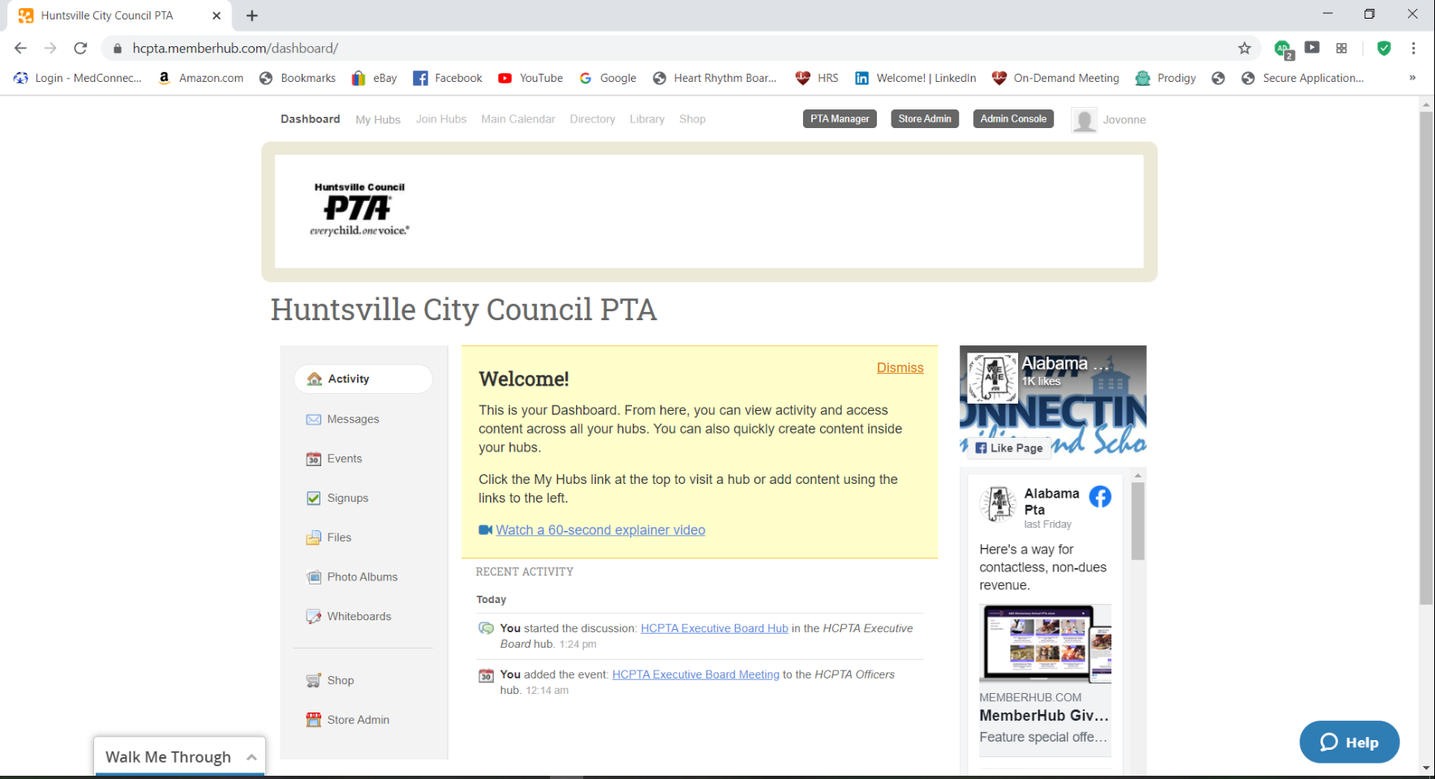
Dashboard

Slide 7
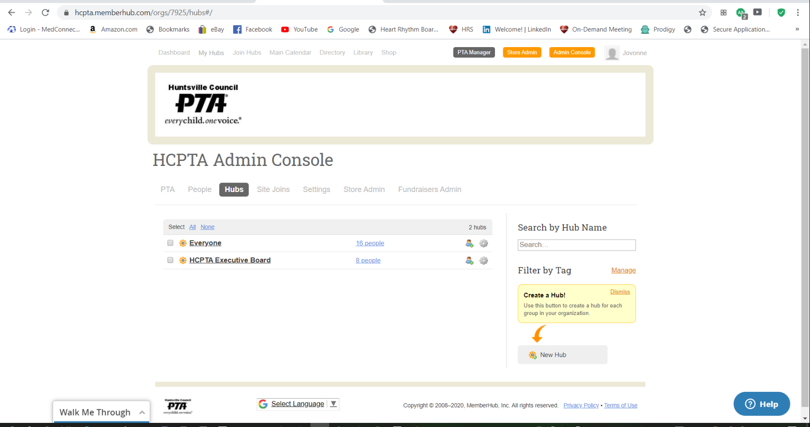
Creating a New Hub

Slide 8
Setting Hub Details

Slide 9
Hub Ideas
Everyone Hub
Principals Hub
PTA Board Hub
Faculty Hub
Reflections Committee Hub
Parents Hub
Room Moms Hub
Students Hub

Slide 10
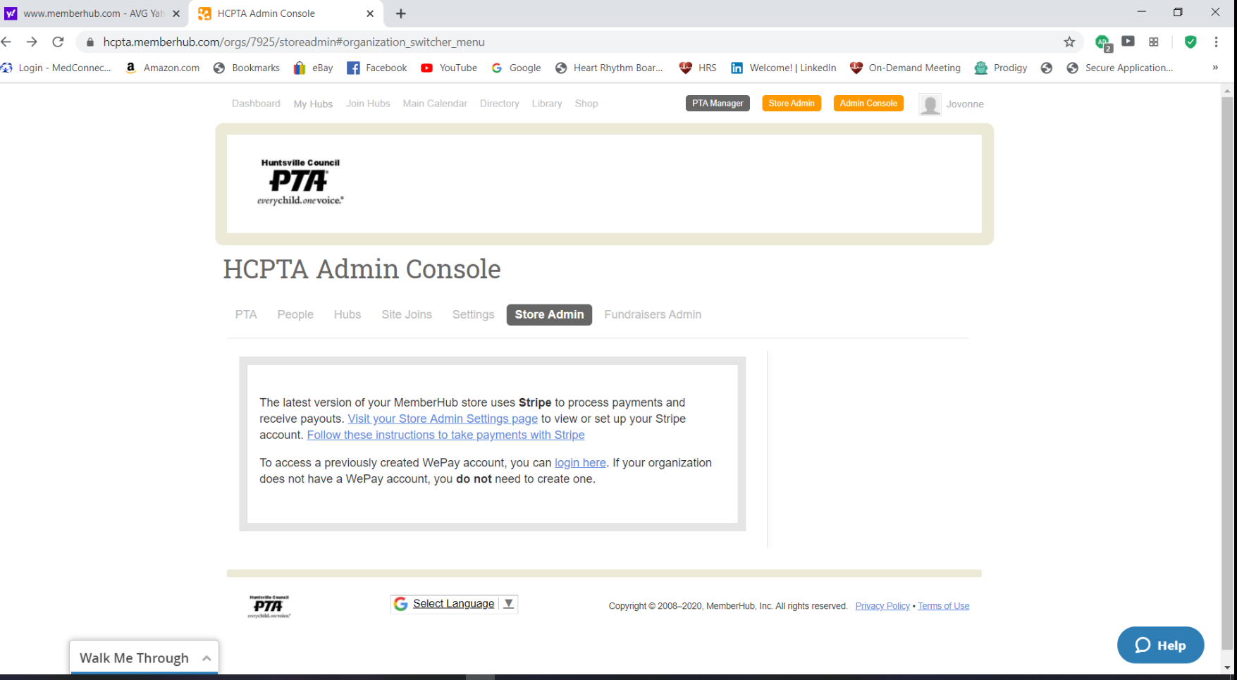
Store Admin

Slide 11
Setting Up Your Stripe Account
https://support.memberhub.com/hc/en-us/articles/360049328313
Cell Phone Number or Email for Verification Code
Legal PTA Name
Legal Representative (President or Treasurer)
Banking Information

Slide 12
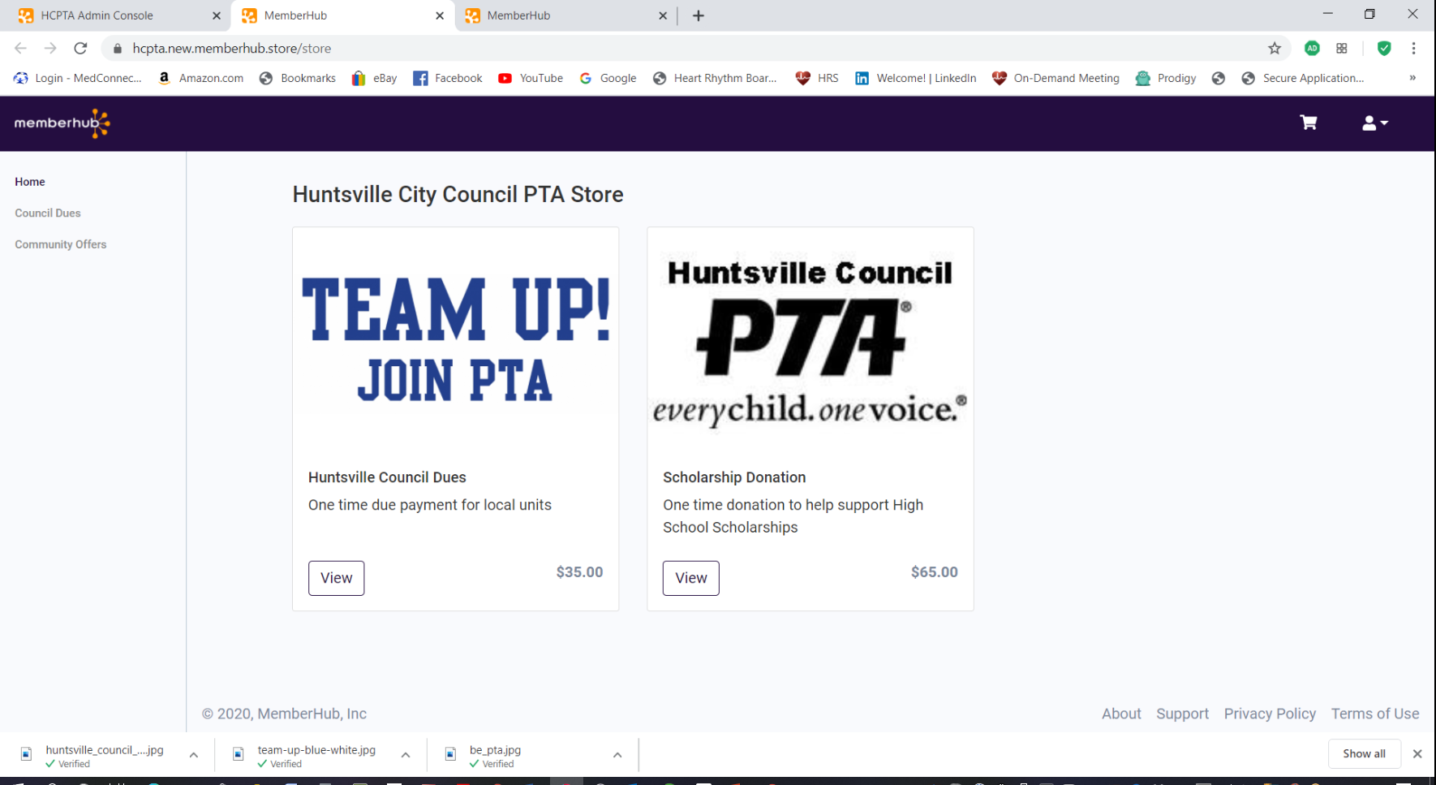
HCPTA Store

Slide 13
Product Ideas
PTA Memberships
School Spirit Wear
School Event Tickets
School Car Magnets

Slide 14
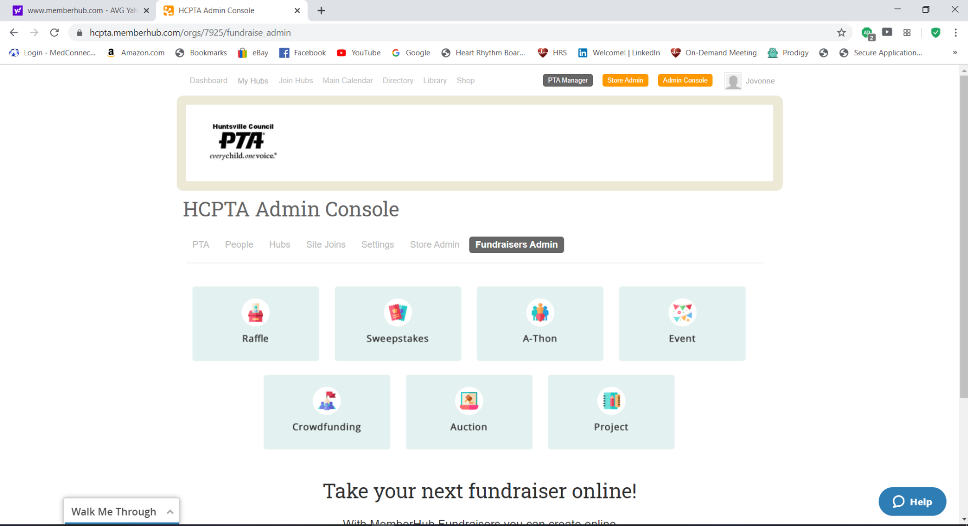
Fundraisers

Slide 15
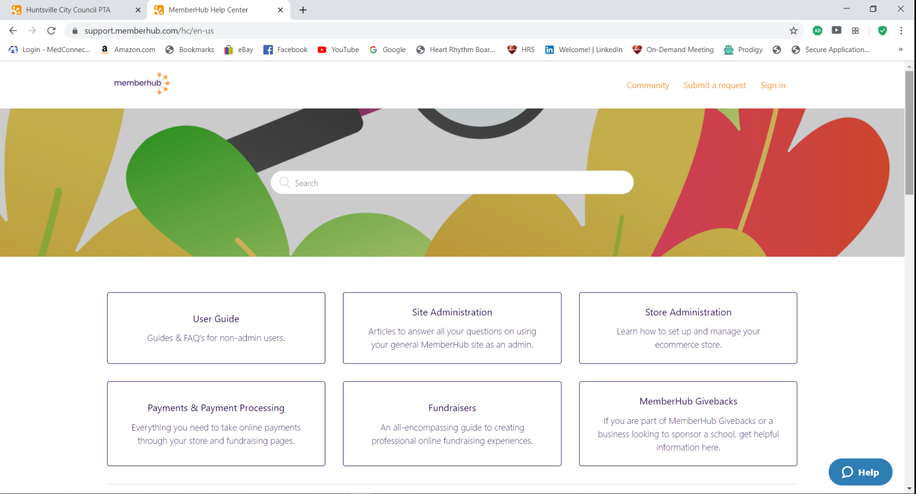
Help Center

Slide 16
Free 1-on-1 Training Sessions

Slide 17
Resources/Websites
https://www.memberhub.com
https://www.pta.org
https://www.alabamapta.org
https://www.huntsvillepta.org
https://www.huntsvillecityschools.org
Questions/Concerns:
Jovonne Foster
Jovonne_williams@hotmail.com
17

Slide 18
New User Video

