Slide 1
Six National Standards
Every Child. One Voice

Slide 2
Why PTA?
Fall Festival?
Book Fairs? Fun Runs?
Fundraising?

Slide 3
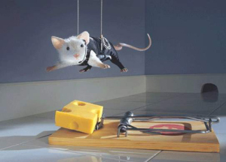
Your Mission, Should you Choose to Accept it….
Student Achievement and Parent Engagement

Slide 4
Welcoming All Families
Do people feel welcomed? Do they feel left out, do they feel marginalized? Worse, do they want to be left out?

Slide 5
Communicating Effectively
Not just prolifically.

Slide 6
Communicating Effectively
Always professionally.

Slide 7
Communicating Effectively
Behave discreetly.
What happens at your school stays at your school.

Slide 8
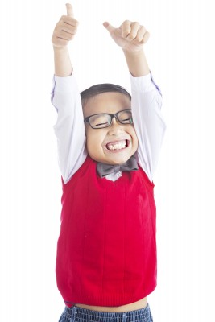
Supporting Student Success
Do your programs and activities come back to the mission statement? Supporting student achievement and parental involvement.
“We have always done this” is not a good enough reason to have a program or event.

Slide 9
Speaking Up for Every Child
Are you speaking up for the students, or are you speaking for yourself?

Slide 10
Sharing Power
Work Together
With Each Other
With your Members
With the Principal
With the Faculty

Slide 11
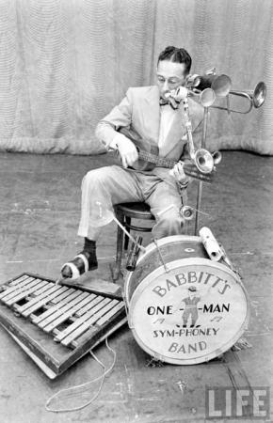
Sharing Power
You can’t do it all alone.
One man bands are fascinating at first, but after awhile…..they are kind of annoying.

Slide 12
Collaborating with Community
What is your definition of collaborating? Having Kohl’s Cares give you $500? Having Publix donate cookies and lemonade?
How has your school been a good community member?

