Slide 1
MARY SCOTT HUNTER
Representative-Alabama Board of Education
District 8 (Limestone, Madison, Jackson, DeKalb, Etowah)

Slide 2
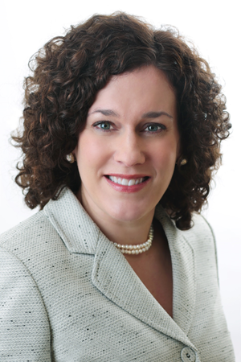
www.maryscotthunter.com

Slide 3
Deep Dive into College and Career Readiness

Slide 4
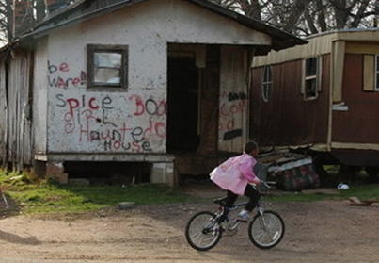
Deep Dive into College and Career Readiness
Quantity and Quality of our Graduates
College Going
Are they Ready?
What are they studying?
Jobs in Alabama
Middle Skills Gap
Understanding the Challenges
What Solutions?
Questions

Slide 5
Graduation Rate Let’s talk Quantity…

Slide 6
Graduation Rate (Statewide)
2011 72%
2012 75%
2013 80%
2014 86%
600 additional students graduate for every 1% increase
90% Grad Rate by 2020 is the Goal
*As Reported from State Department of Education’s Data Center www.alsde.edu

Slide 7
College Going
Five Year Totals - Alabama
 | High School Graduates | College Going | Percent Attending
2008 | 37,389 | 22,821 | 61.04%
2009 | 41,869 | 25,363 | 60.58%
2010 | 42,742 | 25,646 | 60.00%
2011 | 44,086 | 25,324 | 57.44%
2012 | 43,911 | 24,679 | 56.20%
2013 | 44,751 | 24,355 | 54.42%
Total | 254,748 | 148,188 | 58.17%

Slide 8
College and Career Readiness Let’s talk quality…

Slide 9
College & Career Readiness Basis for Change – The Disconnect
Alabama High School
Grad Exam
The ACT
Language 97%
Math 97%
Reading 97%
Science 97%
Social Studies 97%
English(18) 66%
Math(22) 31%
Reading(22) 41%
Science(23) 30%
All Four 20%

Slide 10
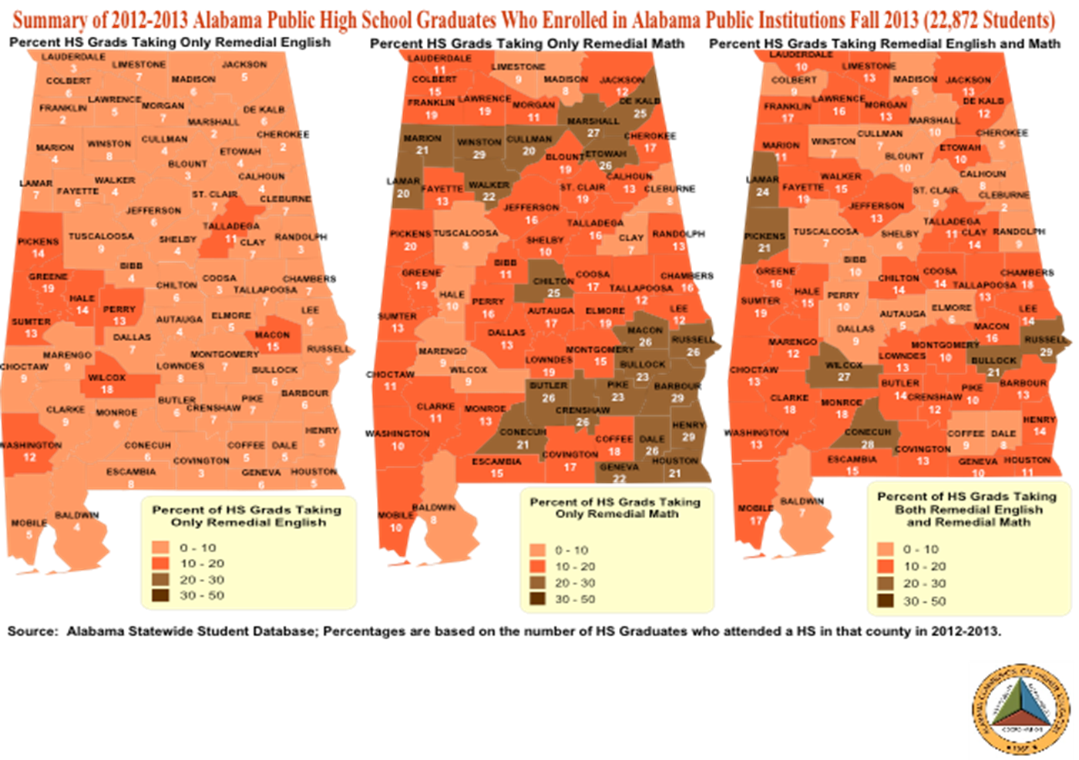
College Readiness -- Remediation Rates

Slide 11
Career Readiness – Middle Skills Gap

Slide 12
What are they taking? Choices of All Undergrads enrolled in AL Public 2YR Colleges
Rank | Occupation | Change in Jobs (2013-2023)
1 | Home Health Aides | 4,010
2 | Personal Care Aides | 6,162
3 | Medical Secretaries | 2,168
4 | Software Developers, Applications | 1,976
5 | Market Research Analysts and Marketing Specialists | 1,103
6 | Medical Assistants | 2,284
7 | Software Developers, Systems Software | 1,291
8 | Computer Systems Analysts | 1,871
9 | Cleaners of Vehicles and Equipment | 1,143
10 | Computer User Support Specialists | 1,760
13 | Pharmacy Technicians | 1,388
14 | Team Assemblers | 5,656
15 | Licensed Practical and Licensed Vocational Nurses | 2,779
17 | Machinists | 1,264
20 | Industrial Machinery Mechanics | 1,537
21 | Registered Nurses | 6,901
Rank | CIP Description | 2-YR College
1 | General Studies. | 39,690
2 | Undeclared. | 6,921
3 | Registered Nursing/Registered Nurse. | 5,585
4 | Liberal Arts and Sciences/Liberal Studies. | 4,783
5 | Administrative Assistant and Secretarial Science, General. | 2,298
6 | Computer and Information Sciences, General. | 1,916
7 | Business Administration and Management, General. | 1,633
8 | Welding Technology/Welder. | 1,334
9 | Licensed Practical/Vocational Nurse Training. | 1,305
10 | Multi-/Interdisciplinary Studies, Other. | 1,152
11 | Child Care and Support Services Management. | 1,130
12 | Emergency Medical Technology/Technician (EMT Paramedic). | 990
13 | Manufacturing Engineering Technology/Technician. | 890
14 | Physical Therapy Technician/Assistant. | 813
15 | Medical/Clinical Assistant. | 806

Slide 13
Projected (2013-2023) Fastest Growing Occupations vs. Degree Choices of All Undergrads enrolled in AL Public 2YR Colleges
Rank | Occupation | Change in Jobs (2013-2023)
1 | Home Health Aides | 4,010
2 | Personal Care Aides | 6,162
3 | Medical Secretaries | 2,168
4 | Software Developers, Applications | 1,976
5 | Market Research Analysts and Marketing Specialists | 1,103
6 | Medical Assistants | 2,284
7 | Software Developers, Systems Software | 1,291
8 | Computer Systems Analysts | 1,871
9 | Cleaners of Vehicles and Equipment | 1,143
10 | Computer User Support Specialists | 1,760
13 | Pharmacy Technicians | 1,388
14 | Team Assemblers | 5,656
15 | Licensed Practical and Licensed Vocational Nurses | 2,779
17 | Machinists | 1,264
20 | Industrial Machinery Mechanics | 1,537
21 | Registered Nurses | 6,901
Rank | CIP Description | 2-YR College
1 | General Studies. | 39,690
2 | Undeclared. | 6,921
3 | Registered Nursing/Registered Nurse. | 5,585
4 | Liberal Arts and Sciences/Liberal Studies. | 4,783
5 | Administrative Assistant and Secretarial Science, General. | 2,298
6 | Computer and Information Sciences, General. | 1,916
7 | Business Administration and Management, General. | 1,633
8 | Welding Technology/Welder. | 1,334
9 | Licensed Practical/Vocational Nurse Training. | 1,305
10 | Multi-/Interdisciplinary Studies, Other. | 1,152
11 | Child Care and Support Services Management. | 1,130
12 | Emergency Medical Technology/Technician (EMT Paramedic). | 990
13 | Manufacturing Engineering Technology/Technician. | 890
14 | Physical Therapy Technician/Assistant. | 813
15 | Medical/Clinical Assistant. | 806

Slide 14
Projected (2013-2023) Fastest Growing Occupations vs. Degree Choices of All Undergrads enrolled in AL Public 2YR Colleges
Rank | Occupation | Change in Jobs (2013-2023)
1 | Home Health Aides | 4,010
2 | Personal Care Aides | 6,162
3 | Medical Secretaries | 2,168
4 | Software Developers, Applications | 1,976
5 | Market Research Analysts and Marketing Specialists | 1,103
6 | Medical Assistants | 2,284
7 | Software Developers, Systems Software | 1,291
8 | Computer Systems Analysts | 1,871
9 | Cleaners of Vehicles and Equipment | 1,143
10 | Computer User Support Specialists | 1,760
13 | Pharmacy Technicians | 1,388
14 | Team Assemblers | 5,656
15 | Licensed Practical and Licensed Vocational Nurses | 2,779
17 | Machinists | 1,264
20 | Industrial Machinery Mechanics | 1,537
21 | Registered Nurses | 6,901
Rank | CIP Description | 2-YR College
1 | General Studies. | 39,690
2 | Undeclared. | 6,921
3 | Registered Nursing/Registered Nurse. | 5,585
4 | Liberal Arts and Sciences/Liberal Studies. | 4,783
5 | Administrative Assistant and Secretarial Science, General. | 2,298
6 | Computer and Information Sciences, General. | 1,916
7 | Business Administration and Management, General. | 1,633
8 | Welding Technology/Welder. | 1,334
9 | Licensed Practical/Vocational Nurse Training. | 1,305
10 | Multi-/Interdisciplinary Studies, Other. | 1,152
11 | Child Care and Support Services Management. | 1,130
12 | Emergency Medical Technology/Technician (EMT Paramedic). | 990
13 | Manufacturing Engineering Technology/Technician. | 890
14 | Physical Therapy Technician/Assistant. | 813
15 | Medical/Clinical Assistant. | 806

Slide 15
Projected (2013-2023) Fastest Growing Occupations vs. Degree Choices of All Undergrads enrolled in AL Public 2YR Colleges
Rank | Occupation | Change in Jobs (2013-2023)
1 | Home Health Aides | 4,010
2 | Personal Care Aides | 6,162
3 | Medical Secretaries | 2,168
4 | Software Developers, Applications | 1,976
5 | Market Research Analysts and Marketing Specialists | 1,103
6 | Medical Assistants | 2,284
7 | Software Developers, Systems Software | 1,291
8 | Computer Systems Analysts | 1,871
9 | Cleaners of Vehicles and Equipment | 1,143
10 | Computer User Support Specialists | 1,760
13 | Pharmacy Technicians | 1,388
14 | Team Assemblers | 5,656
15 | Licensed Practical and Licensed Vocational Nurses | 2,779
17 | Machinists | 1,264
20 | Industrial Machinery Mechanics | 1,537
21 | Registered Nurses | 6,901
Rank | CIP Description | 2-YR College
1 | General Studies. | 39,690
2 | Undeclared. | 6,921
3 | Registered Nursing/Registered Nurse. | 5,585
4 | Liberal Arts and Sciences/Liberal Studies. | 4,783
5 | Administrative Assistant and Secretarial Science, General. | 2,298
6 | Computer and Information Sciences, General. | 1,916
7 | Business Administration and Management, General. | 1,633
8 | Welding Technology/Welder. | 1,334
9 | Licensed Practical/Vocational Nurse Training. | 1,305
10 | Multi-/Interdisciplinary Studies, Other. | 1,152
11 | Child Care and Support Services Management. | 1,130
12 | Emergency Medical Technology/Technician (EMT Paramedic). | 990
13 | Manufacturing Engineering Technology/Technician. | 890
14 | Physical Therapy Technician/Assistant. | 813
15 | Medical/Clinical Assistant. | 806

Slide 16
What are they taking? Choices of All Undergrads enrolled in AL Public 4YR Colleges
Rank | Occupation | Change in Jobs (2013-2023)
1 | Home Health Aides | 4,010
2 | Personal Care Aides | 6,162
3 | Medical Secretaries | 2,168
4 | Software Developers, Applications | 1,976
5 | Market Research Analysts and Marketing Specialists | 1,103
6 | Medical Assistants | 2,284
7 | Software Developers, Systems Software | 1,291
8 | Computer Systems Analysts | 1,871
9 | Cleaners of Vehicles and Equipment | 1,143
10 | Computer User Support Specialists | 1,760
13 | Pharmacy Technicians | 1,388
14 | Team Assemblers | 5,656
15 | Licensed Practical and Licensed Vocational Nurses | 2,779
17 | Machinists | 1,264
20 | Industrial Machinery Mechanics | 1,537
21 | Registered Nurses | 6,901
Rank | CIP Description | Four-Year
1 | Undeclared. | 14,122
2 | Business Administration and Management, General. | 8,026
3 | Registered Nursing/Registered Nurse. | 7,570
4 | Biology/Biological Sciences, General. | 5,527
5 | Psychology, General. | 4,757
6 | Accounting. | 4,124
7 | Elementary Education and Teaching. | 4,123
8 | Liberal Arts and Sciences, General Studies and Humanities, Other. | 2,958
9 | Mechanical Engineering. | 2,823
10 | Finance, General. | 2,690
11 | Physical Education Teaching and Coaching. | 2,624
12 | Computer and Information Sciences, General. | 2,484
13 | Business/Commerce, General. | 2,405
14 | Marketing/Marketing Management, General. | 2,102
15 | Criminal Justice/Safety Studies. | 2,100

Slide 17
Projected (2013-2023) Fastest Growing Occupations vs. Degree Choices of All Undergrads enrolled in AL Public 4YR Colleges
Rank | Occupation | Change in Jobs (2013-2023)
1 | Home Health Aides | 4,010
2 | Personal Care Aides | 6,162
3 | Medical Secretaries | 2,168
4 | Software Developers, Applications | 1,976
5 | Market Research Analysts and Marketing Specialists | 1,103
6 | Medical Assistants | 2,284
7 | Software Developers, Systems Software | 1,291
8 | Computer Systems Analysts | 1,871
9 | Cleaners of Vehicles and Equipment | 1,143
10 | Computer User Support Specialists | 1,760
13 | Pharmacy Technicians | 1,388
14 | Team Assemblers | 5,656
15 | Licensed Practical and Licensed Vocational Nurses | 2,779
17 | Machinists | 1,264
20 | Industrial Machinery Mechanics | 1,537
21 | Registered Nurses | 6,901
Rank | CIP Description | Four-Year
1 | Undeclared. | 14,122
2 | Business Administration and Management, General. | 8,026
3 | Registered Nursing/Registered Nurse. | 7,570
4 | Biology/Biological Sciences, General. | 5,527
5 | Psychology, General. | 4,757
6 | Accounting. | 4,124
7 | Elementary Education and Teaching. | 4,123
8 | Liberal Arts and Sciences, General Studies and Humanities, Other. | 2,958
9 | Mechanical Engineering. | 2,823
10 | Finance, General. | 2,690
11 | Physical Education Teaching and Coaching. | 2,624
12 | Computer and Information Sciences, General. | 2,484
13 | Business/Commerce, General. | 2,405
14 | Marketing/Marketing Management, General. | 2,102
15 | Criminal Justice/Safety Studies. | 2,100

Slide 18
Projected (2013-2023) Fastest Growing Occupations vs. Degree Choices of All Undergrads enrolled in AL Public 4YR Colleges
Rank | Occupation | Change in Jobs (2013-2023)
1 | Home Health Aides | 4,010
2 | Personal Care Aides | 6,162
3 | Medical Secretaries | 2,168
4 | Software Developers, Applications | 1,976
5 | Market Research Analysts and Marketing Specialists | 1,103
6 | Medical Assistants | 2,284
7 | Software Developers, Systems Software | 1,291
8 | Computer Systems Analysts | 1,871
9 | Cleaners of Vehicles and Equipment | 1,143
10 | Computer User Support Specialists | 1,760
13 | Pharmacy Technicians | 1,388
14 | Team Assemblers | 5,656
15 | Licensed Practical and Licensed Vocational Nurses | 2,779
17 | Machinists | 1,264
20 | Industrial Machinery Mechanics | 1,537
21 | Registered Nurses | 6,901
Rank | CIP Description | Four-Year
1 | Undeclared. | 14,122
2 | Business Administration and Management, General. | 8,026
3 | Registered Nursing/Registered Nurse. | 7,570
4 | Biology/Biological Sciences, General. | 5,527
5 | Psychology, General. | 4,757
6 | Accounting. | 4,124
7 | Elementary Education and Teaching. | 4,123
8 | Liberal Arts and Sciences, General Studies and Humanities, Other. | 2,958
9 | Mechanical Engineering. | 2,823
10 | Finance, General. | 2,690
11 | Physical Education Teaching and Coaching. | 2,624
12 | Computer and Information Sciences, General. | 2,484
13 | Business/Commerce, General. | 2,405
14 | Marketing/Marketing Management, General. | 2,102
15 | Criminal Justice/Safety Studies. | 2,100

Slide 19
Projected (2013-2023) Fastest Growing Occupations vs. Degree Choices of All Undergrads enrolled in AL Public 4YR Colleges
Rank | Occupation | Change in Jobs (2013-2023)
1 | Home Health Aides | 4,010
2 | Personal Care Aides | 6,162
3 | Medical Secretaries | 2,168
4 | Software Developers, Applications | 1,976
5 | Market Research Analysts and Marketing Specialists | 1,103
6 | Medical Assistants | 2,284
7 | Software Developers, Systems Software | 1,291
8 | Computer Systems Analysts | 1,871
9 | Cleaners of Vehicles and Equipment | 1,143
10 | Computer User Support Specialists | 1,760
13 | Pharmacy Technicians | 1,388
14 | Team Assemblers | 5,656
15 | Licensed Practical and Licensed Vocational Nurses | 2,779
17 | Machinists | 1,264
20 | Industrial Machinery Mechanics | 1,537
21 | Registered Nurses | 6,901
Rank | CIP Description | Four-Year
1 | Undeclared. | 14,122
2 | Business Administration and Management, General. | 8,026
3 | Registered Nursing/Registered Nurse. | 7,570
4 | Biology/Biological Sciences, General. | 5,527
5 | Psychology, General. | 4,757
6 | Accounting. | 4,124
7 | Elementary Education and Teaching. | 4,123
8 | Liberal Arts and Sciences, General Studies and Humanities, Other. | 2,958
9 | Mechanical Engineering. | 2,823
10 | Finance, General. | 2,690
11 | Physical Education Teaching and Coaching. | 2,624
12 | Computer and Information Sciences, General. | 2,484
13 | Business/Commerce, General. | 2,405
14 | Marketing/Marketing Management, General. | 2,102
15 | Criminal Justice/Safety Studies. | 2,100

Slide 20
Summer 2012 - Spring 2013 COMPLETIONS of Students – All AL 2YR & 4YR Public Colleges VS. Projected Job Growth (2013-2023)
Rank | Major | State Totals
1 | Registered Nursing/Registered Nurse. | 3650
2 | General Studies. | 3130
3 | Bus. Administration and Mgmt, General. | 1641
4 | Elementary Education and Teaching. | 1199
5 | Accounting. | 935
6 | Psychology, General. | 897
7 | Licensed Practical/Vocational Nurse Training. | 759
8 | Liberal Arts and Sciences/Liberal Studies. | 719
9 | Biology/Biological Sciences, General. | 716
10 | Admin. Assistant/Secretarial Science, General. | 664
11 | Emergency Medical Technology/Technician (EMT Paramedic). | 656
13 | Computer and Information Sciences, General. | 612
18 | Welding Technology/Welder. | 420
20 | Criminal Justice/Safety Studies. | 396
21 | Finance, General. | 376
Rank | Occupation | Change in Jobs (2013-2023)
1 | Home Health Aides | 4,010
2 | Personal Care Aides | 6,162
3 | Medical Secretaries | 2,168
4 | Software Developers, Applications | 1,976
5 | Market Research Analysts and Marketing Specialists | 1,103
6 | Medical Assistants | 2,284
7 | Software Developers, Systems Software | 1,291
8 | Computer Systems Analysts | 1,871
9 | Cleaners of Vehicles and Equipment | 1,143
10 | Computer User Support Specialists | 1,760
13 | Pharmacy Technicians | 1,388
14 | Team Assemblers | 5,656
15 | Licensed Practical and Licensed Vocational Nurses | 2,779
17 | Machinists | 1,264
20 | Industrial Machinery Mechanics | 1,537
21 | Registered Nurses | 6,901

Slide 21
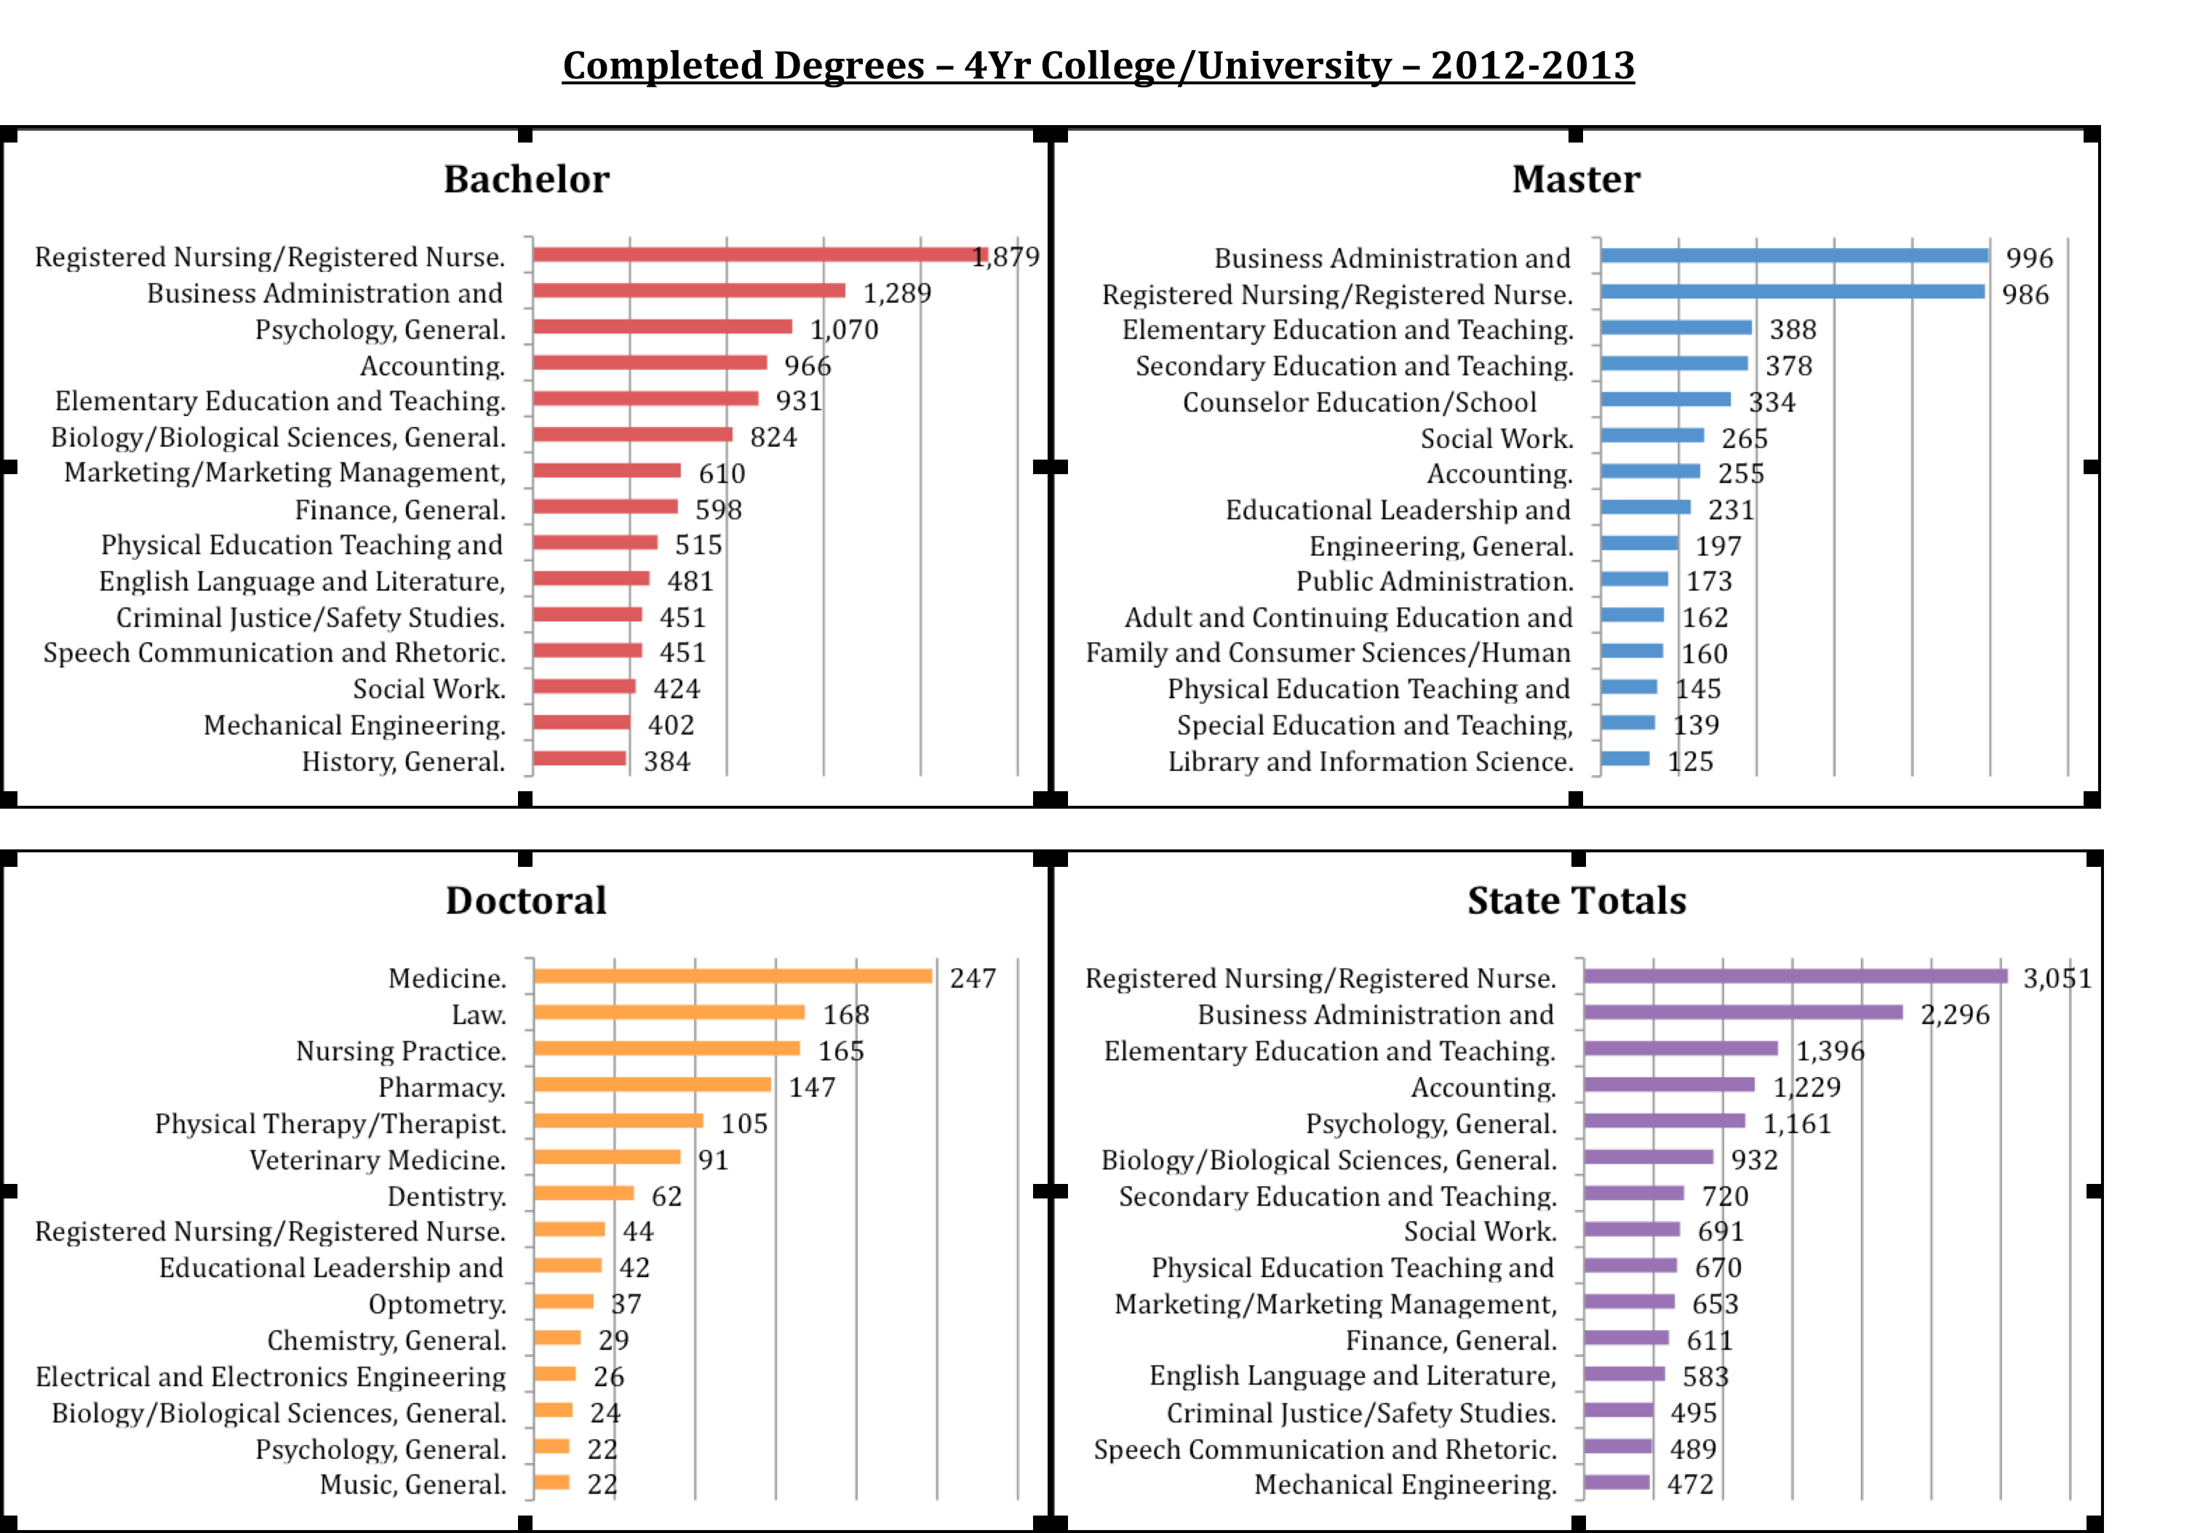

Slide 22
Understand the Challenges
http://alabamapossible.org/

Slide 23
Understand the Challenges
4.8 million – Alabama’s population
32,500 – Alabama citizens currently incarcerated in the State Prison System
479,000 - Working age adults in Alabama without high school credentials
459,000 - Underemployed Alabamians
790,000 – Job openings in Alabama between now and 2020
50% - Workers eligible to retire TODAY!
114,533 / 2020; 218,904 / 2030 – projected worker shortfall in Alabama

Slide 24
Understand the Challenges
More than 1 in 6 Alabamians live in poverty. 17.5 percent of Alabamians live below the federal poverty line, which is $21,954 in household earnings for a family of four
1 in 4 children in Alabama live in poverty
The gap between Alabama’s richest and poorest is the second largest in the nation.
Alabama ranks 42nd in the nation in per capita income. Nearly 60 percent of that wage gap can be attributed to our high school drop out rate, which was 41.4 percent in 2007
Alabama is the second most obese state in the country and has the fourth highest rate of diabetes among adults.
2nd hungriest state in the nation and 25 percent of Alabamians experienced food hardship in 2010.
http://alabamapossible.org/

Slide 25
Understand the Challenges
Alabama Public School Students in Poverty (qualify for reduced or free lunches): 72%
Individuals with a high school degree: 82.1%
Individuals with a four year college degree: 23.3%
Teens ages 16 to 19 not attending school and not working: 10%
Percent of college students with debt: 54%

Slide 26
Understand the Challenges
4.8 million – Alabama’s population
32,500 – Alabama citizens currently incarcerated in the State Prison System
479,000 - Working age adults in Alabama without high school credentials
459,000 - Underemployed Alabamians
790,000 – Job openings in Alabama between now and 2020
50% - Workers eligible to retire TODAY!
114,533 / 2020; 218,904 / 2030 – projected worker shortfall in Alabama

Slide 27
Understand the Challenges
Skills Gap
Retirement Bubble
Need Skilled Trades People
Need Workers with Soft Skills

Slide 28
What K-12 Solutions?
K-12 Strategic Plan 2020 which seeks to increase the Quantity and Quality of our graduates
Promote CTE, Industry Credentials, Leadership, Career Awareness
Steer students to make smart decisions about college and career
Collaboration between Business and Industry and Education

Slide 29
What 2-Year College Solutions?
Dual Enrollment, Apprenticeships, Internships
Promote CTE, Industry Credentials, Leadership, Career Awareness
Steer students to make smart decisions about college and career
Collaboration between Business and Industry and Education

Slide 30
What 4-Year College Solutions?
Hands-on opportunities
Internships
Change student interests / Promote available job opportunities
Deal with skyrocketing costs

Slide 31
Many Thanks to…

Slide 32
“All one can really leave one's children is what's inside their heads. Education, in other words, and not earthly possessions, is the ultimate legacy, the only thing that cannot be taken away.”
~ Werner Von Braun

Slide 33
“All one can really leave one's children is what's inside their heads. Education, in other words, and not earthly possessions, is the ultimate legacy, the only thing that cannot be taken away.”
~ Werner Von Braun
QUESTIONS?
Mary Scott Hunter
District 8, Alabama State Board of Education
www.maryscotthunter.com

